Slide 2
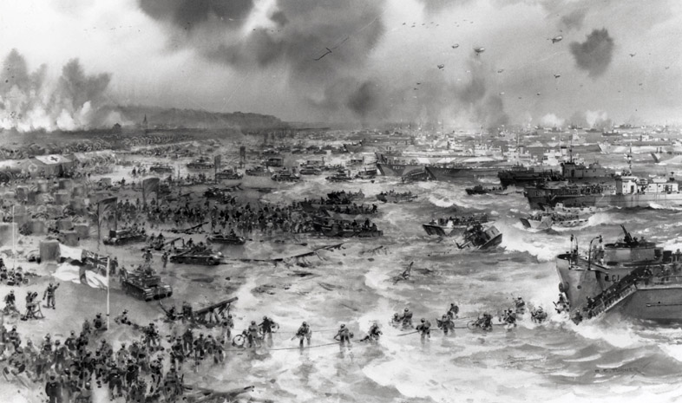

Slide 3
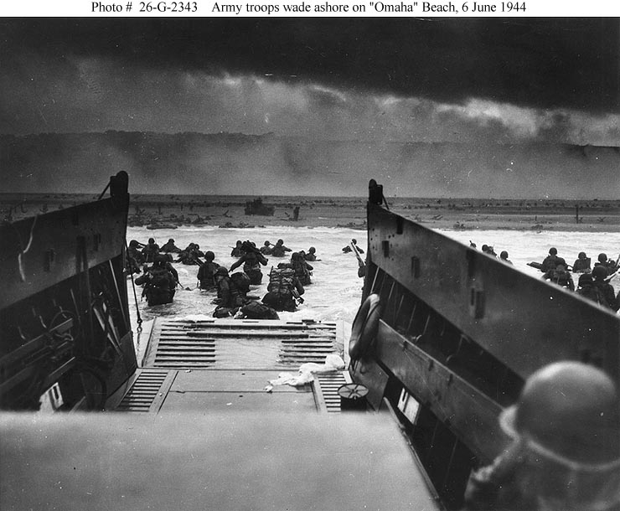

Slide 4
IALT: Understand the events which led to the end of WW2
IK: that the same event can be portrayed as a success or failure depending on viewpoint

Slide 5
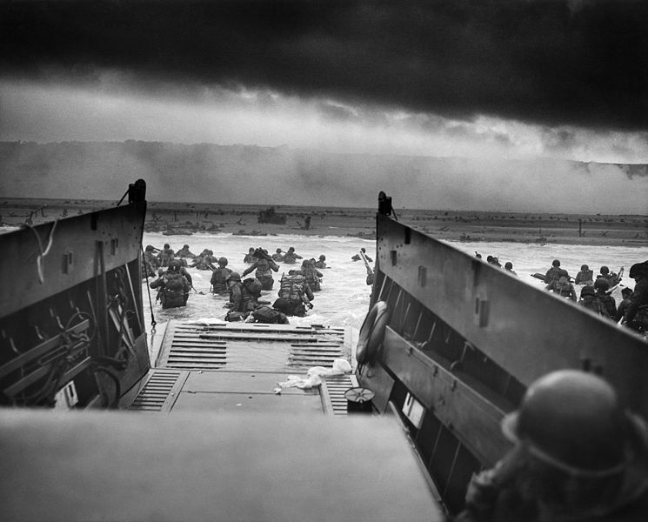
D-Day
The term D-Day refers to a specific date for a planned operation,
often a military attack.
However, the term D-Day has also become synonymous with the allied attack on the beaches of Normandy which took place on 6th June 1944.
Photo courtesy of Chief Photographer's Mate (CPHoM) Robert F. Sargent (@wikicommons) - granted under creative commons licence

Slide 6
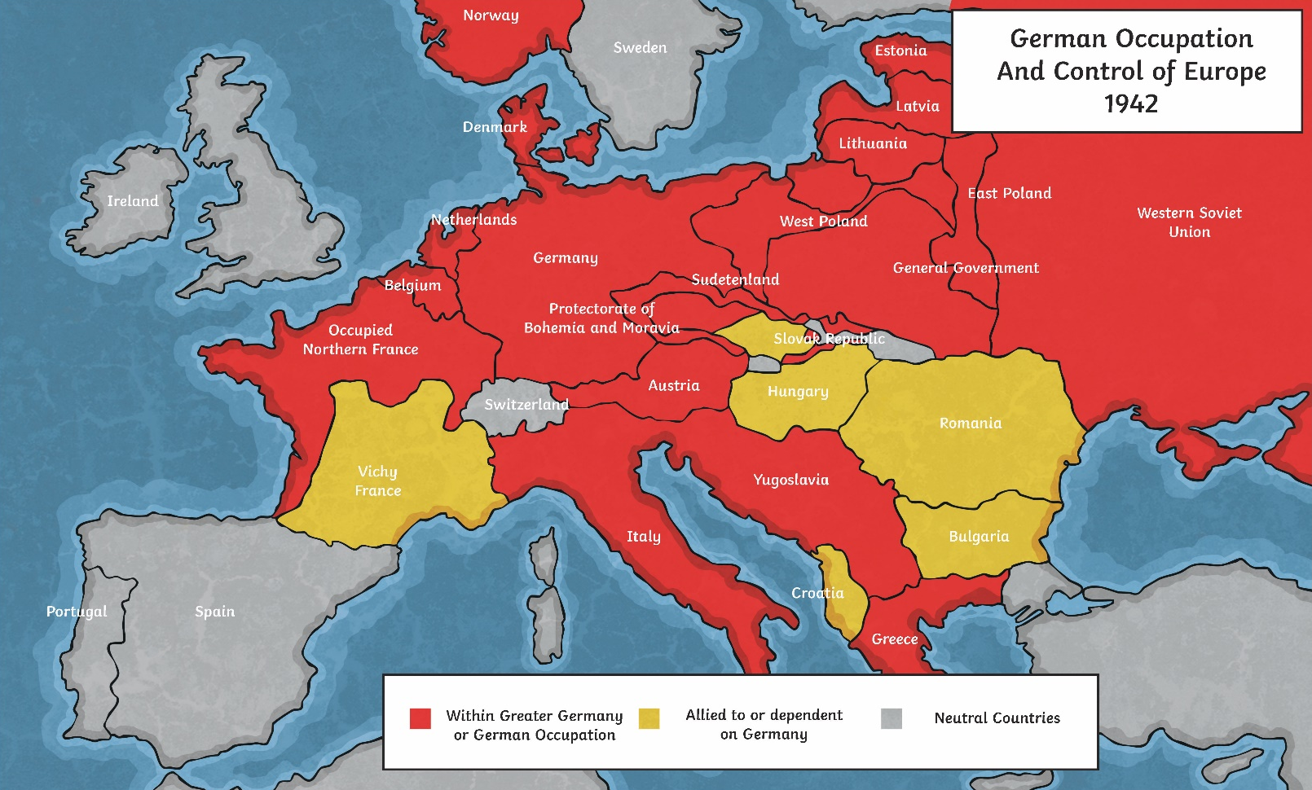
The Atlantic Wall
During the Second World War, Germany was in control of much of Europe.
This map shows which countries were controlled by Nazi Germany in 1942.

Slide 7
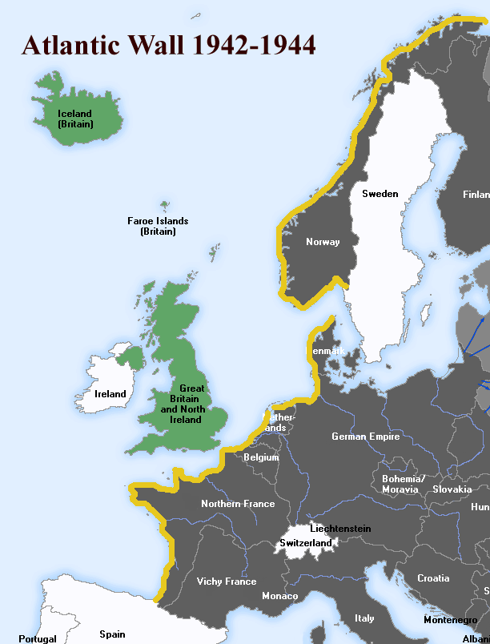
The Atlantic Wall
Strongholds secured by Germany in France were fiercely defended and Adolf Hitler ordered the construction of fortifications - known as the Atlantic Wall - along the coastal regions of north-western Europe and Scandinavia in preparation for an expected Allied attack by Great Britain.
Note: Britain occupied the Faroe Islands and Iceland during the war.
Photo courtesy of User:Uberstroker (@wikicommons) - granted under creative commons licence

Slide 8
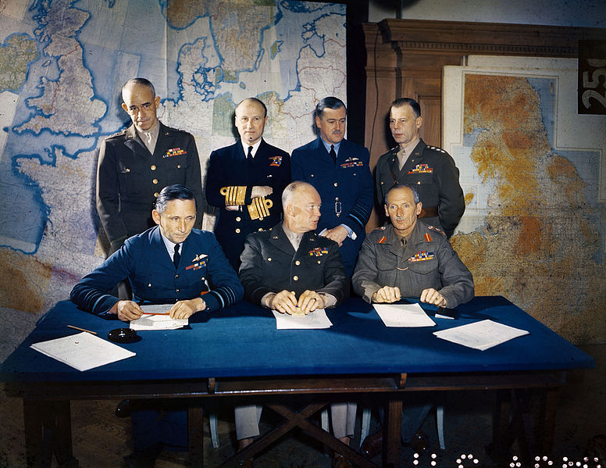
Operation Overlord
From early on in the war, it was clear that in order to secure Allied success, the liberation of north-west Europe from German control was vital. The Allies made plans to try and drive the Germans out of France.
They planned Operation Overlord - a huge military assault which would combine naval, land and airborne attacks on the Germans in France.

Slide 9
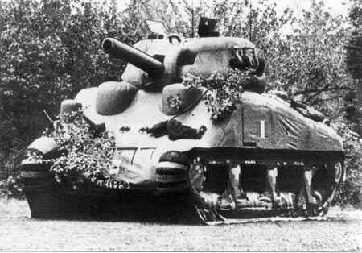

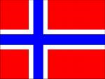
Deception... Operation Bodyguard
The campaign of allied deception leading up to D Day.
Inflatable tanks were parked at ports in eastern and southern Britain for the Luftwaffe to photograph
Germany had a large number of secret agents in Britain but they had been turned by the British as part of the Double Cross System
Q. Explain the purpose of Operation Bodyguard and some of the tactics used.
Using the German agents that had been turned the Allies fed the Germans misinformation, some of which led the German army to expect an attack in either Norway or southern France, instead of Normandy

Slide 10
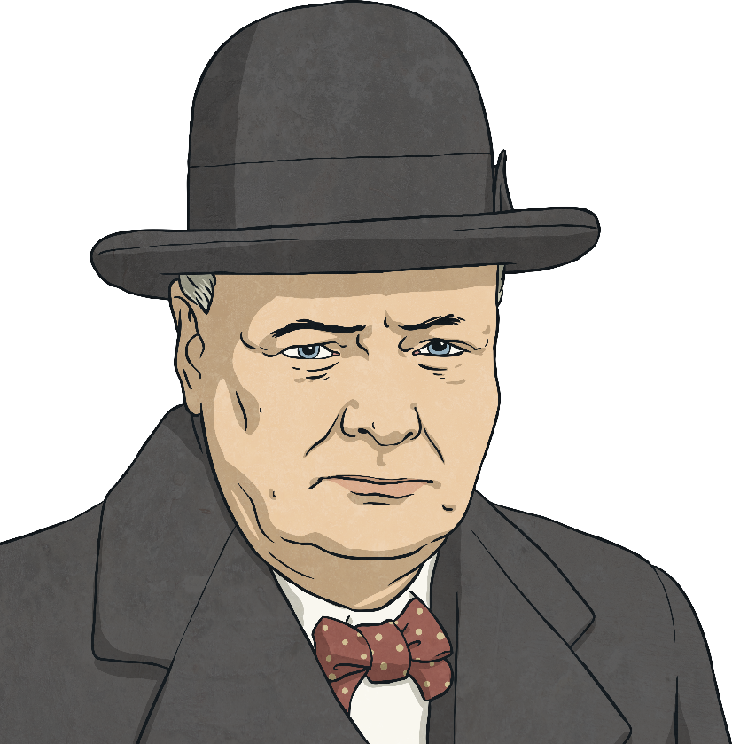
Operation Overlord
Every detail of the operation was so intricately planned that it took over two years to put the plan into action. Operation Overlord was the biggest military operation the world had ever seen and was a collaborative effort between more than 12 countries.
And what a plan!
“This vast operation is undoubtedly the most complicated and difficult that has ever occurred.”
- Winston Churchill

Slide 11
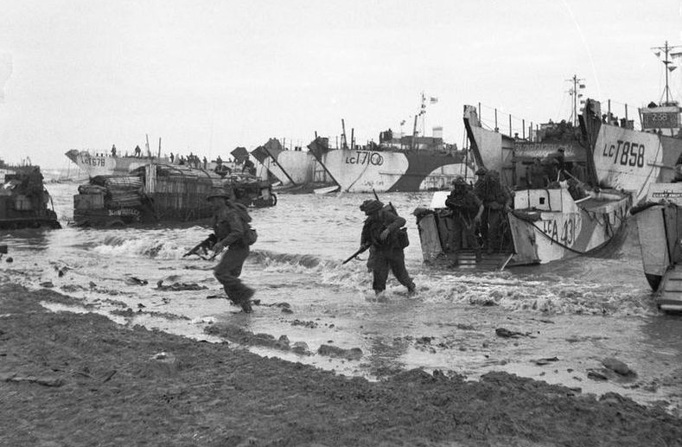
Operation Neptune
The Normandy Landings, which were code-named Operation Neptune, were the first stage of Operation Overlord.
At just after midnight on 6th June 1944, the operation began.
Five key beaches were targeted. Securing control of these areas would give the Allies the best possible chance of fully penetrating into France and completing their ultimate objective.
Soldiers arriving on Sword beach

Slide 12
The Beaches
The stretches of beach were given different code names and troops from Britain, America and Canada led the attacks.
Utah – attack led by American troops;
Omaha – attack led by American troops;
Gold – attack led by British troops;
Juno – attack led by Canadian troops;
Sword – attack led by British troops.

Slide 13
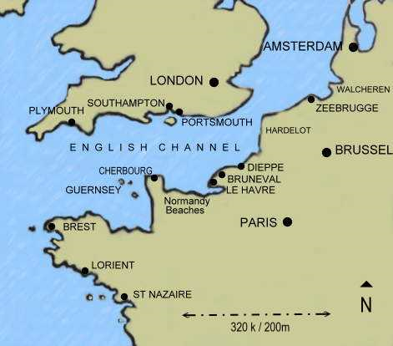
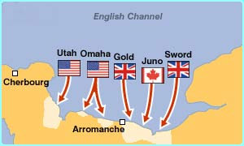

Slide 14
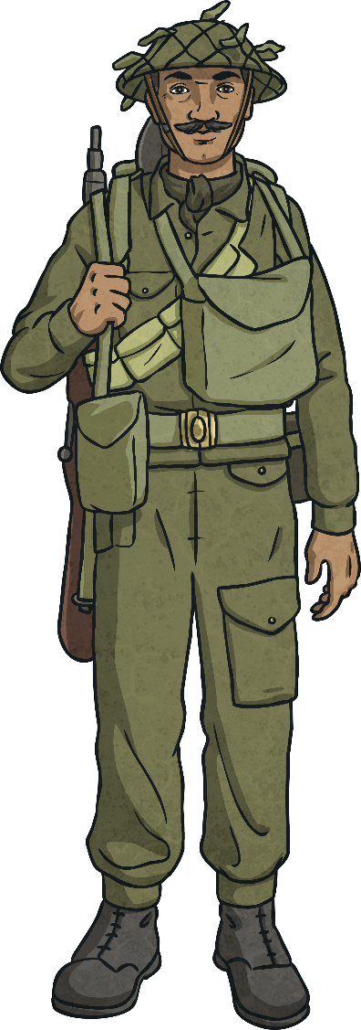
Executing the Plan
Just after midnight on 6th June, Allied paratroopers are dropped behind enemy lines to undermine German defences.
From 6:30am, Allied troops land on the beaches. The shallow waters allow them to wade ashore quietly and take the enemy by surprise.
Throughout the day, Allied air forces overpower the German Luftwaffe and gain control of the airspace.
Allied warships also fire bombs to weaken the German defences along the Atlantic Wall.

Slide 15
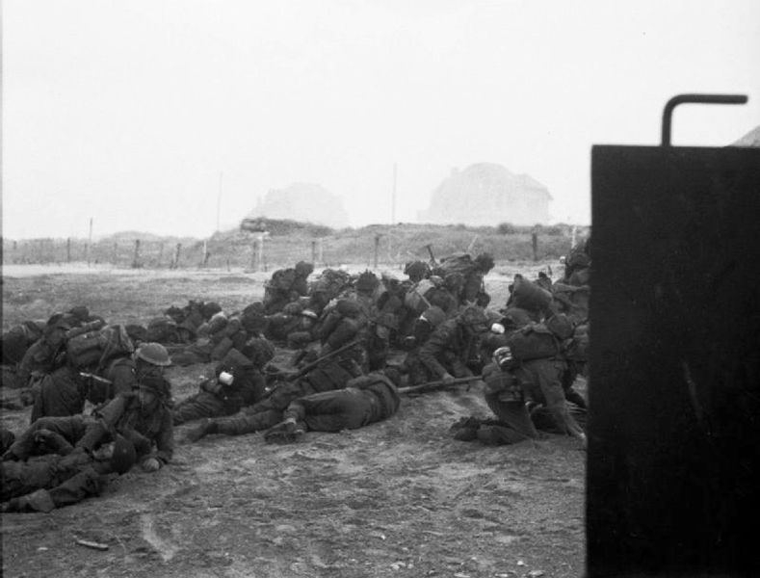
Securing a Foothold
The Allies suffered heavy casualties during the Normandy Landings and did not manage to completely liberate all the beaches or complete all their objectives on the first day.
However, they did manage to secure a foothold which allowed them to continue the operation. The Allies would eventually succeed in liberating France from
Nazi control.

Slide 16
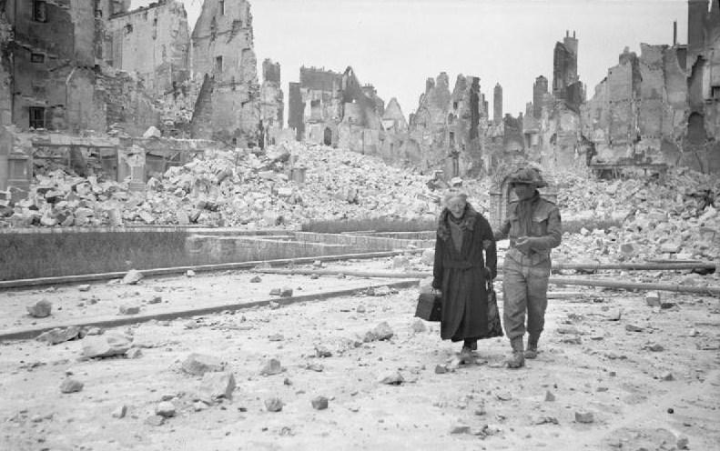
Completing the Mission
Operation Overlord completed its mission fully on 30th August 1944, when the last of the Germans retreated from France.
The Normandy Landings were a major turning point in the war; there would be further battles still to fight. However, D-Day clearly marked
out the beginning of the end of the war.
A British soldier helps a French civilian in Caen

Slide 17
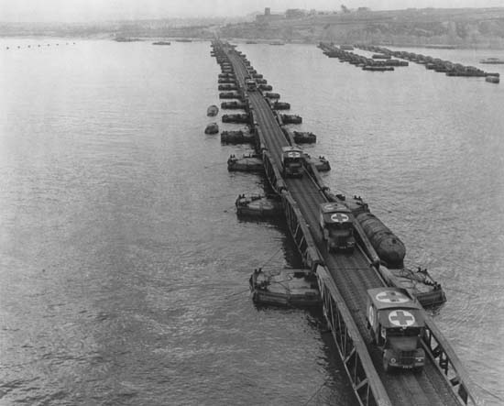
Floating Harbour
The allies built floating harbours by the end of D Day so they could transport cargo quickly from one place to another.

