Slide 1


Welcome to Team Beraet
One Childhood, One Chance
Together we make a difference

Slide 2

What we’ll cover:
The school day
Learning
Core Values
Behaviour for learning
Home Learning
Home Reading
Mathletics
Other information
Questions

Slide 3
The School Day:
APPROXIMATE TIMES! (Monday – Thursday. 3:00 finish on Friday)
8:15 – doors open, early morning work
8:30 – Guided Reading
9:00 – assembly
9:25-10:25 – Maths
10:25-10:40 – break
10:40-11:10 – SPAG
11:10 – 12:00 – English (Read, Write Inc if applicable)
12:00-1:00 – Lunch
1:00 – 2:00 – RAPS curriculum (topic)
2:00-2:15 – Break
3:00 - 3:15 – Session One Arts curriculum
3:15 – 4:15 – Session Two Arts curriculum
4:15 - End of the day

Slide 4
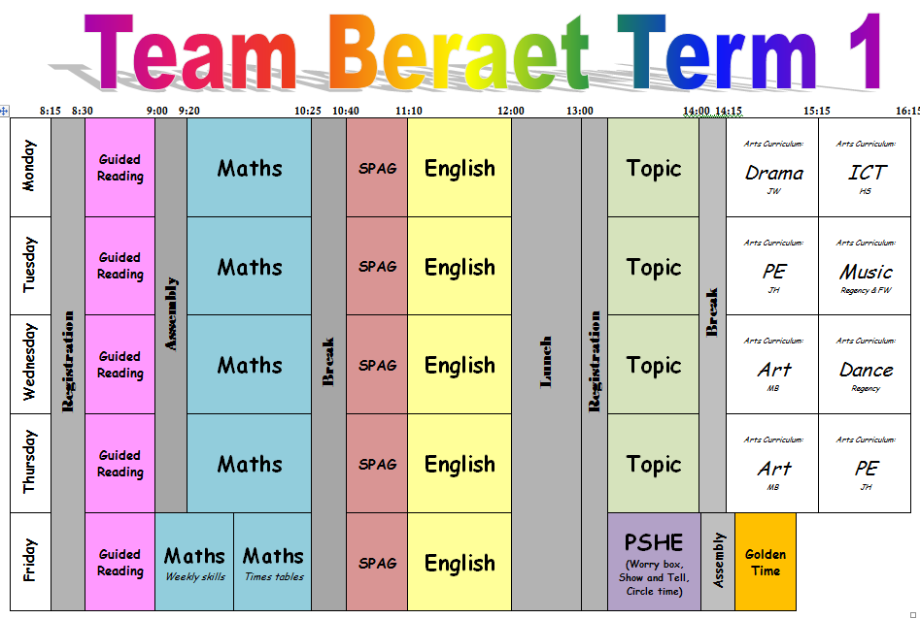
The School Day:
Early morning routine / expectations
Arts curriculum days for class
Snacks for break
Toilet and drink
Pencil cases

Slide 5
Learning
Maths – Term 1 - Place Value (numerals and written word), Addition (written and mental methods) and Subtraction (written and mental methods).
RAPS Curriculum– Term 1 – Our Electric World
English – Term1 – Authors and Letters
Website will show termly update

Slide 6
Our Core Values…
These are at the heart of everything we do at Ramsgate Arts Primary School.
Engagement
Enquiry
Diversity
Aspiration
Challenge
Collaboration
Autonomy

Slide 7
Behaviour For Learning
At RAPS, we want our children to be ready to learn.
Happy Safe Successful

Slide 8

3
2
4
1
5
Hand signal

Slide 9
What are RAPS
Golden Rules?
Expected Behaviour at RAPS

Slide 10
Behaviour Points
Each child starts off with 5 points at the beginning of every day.
Possible total of 25 points a week. Expected to keep all 25 points!
The points will also be looked at on a 3 weekly basis. 25 x 3 = 75 points

Slide 11

Sanctions
If a child is:
talking
messing around
refusing to work
rude
disrupting the lesson etc
a NV warning, a verbal warning then a
yellow warning card
gets placed on the desk in front of you. This will act as a reminder to the child that they have got to improve their behaviour.

Slide 12

If a child improves their behaviour they can then earn the yellow card back. The yellow card can then be removed from the table.
If a child continues to misbehave the yellow card is changed to a red card.

Slide 13
If a child has a yellow card on their desk at the end of the lesson they lose 1 point.
If a child has a red card on their desk at the end of the lesson they lose 2 points.

Slide 14
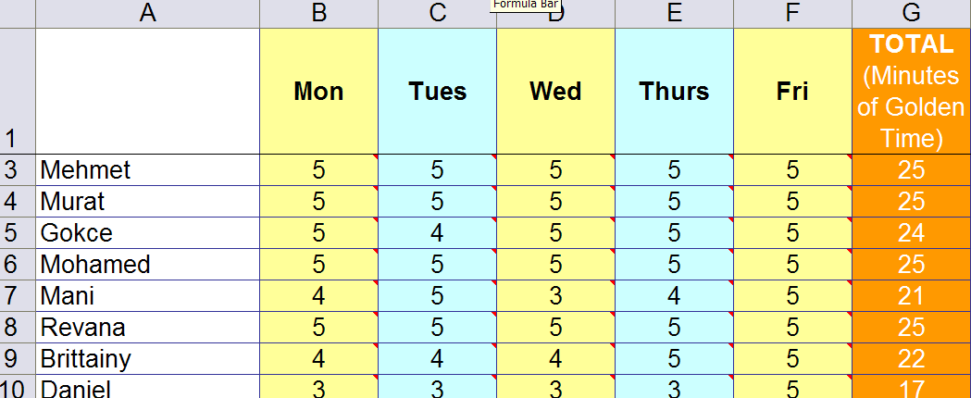
Behaviour Points

Slide 15

Daily rewards
Verbal praise
Smiles
Superstar Learner cards. (If a child has a Superstar learner card on their table at the end of the lesson they can swap it for a house point as they leave).

Slide 16
Weekly Rewards
25 points= All golden time and text home.
22-24 points= All golden time.
11-19= Teacher to contact parents.
6-10 points= Mr Budge to send letter home to inform parents.
5 points or less= Mr Budge to have a meeting with parents.

Slide 17
Three week rewards
75 points= Letter home (emailed). Badge to wear.
3rd badge: RAPS lanyard
6th badge: silver behaviour badge
12th badge: Gold behaviour badge

Slide 18
Class rewards
Three week rewards
The class with the most points in each key stage gets a £3.00 RAPS Cheque to display in their classroom.
At the end of terms 2, 4 and 6 each class can ‘cash’ in their cheques to buy something for the class as a reward/treat. For example, an ice-cream each down the beach.

Slide 19
Home Learning
Love 2 learn will be assigned every 3 weeks
Home reading should be happening regularly – preferably every night, but at least 4 times a week
Spellings every week
KS2-Mathletics assigned every week – tables focus/reinforcing learning activity

Slide 20
Home Reading
Ideally read every night.
Expectation is to read at least 4 times a week.
Use of Bug Club is primary tool.
Banded books also available.
Home books and library books also accepted.
Reading record is just for optional recording of books read by child (Race to reading).

Slide 21
Mathletics
Accessible from home.
Tasks will be set from time to time.
Tool to support learning
Half hour in class a fortnight.
A quick demonstration...

Slide 22
Other information
School Uniform expectations
PE kits
Reading books can be changed whenever your child has finished their book.
Class blogs -3 x weekly letting you know what is going on in classroom plus homework blog
Open door policy: come and chat with us!

Slide 23

Any Questions?

