Slide 1
Pig Heart Boy
IALTs:
To be able to make predictions about a novel.
To learn at least three facts about an author.
KEYWORDS:
NOVEL
AUTHOR
HEART
TRANSPLANT
We are going to be reading a book called ‘Pig Heart Boy’.
Strange title isn’t it?

Slide 2
Write down in your own words…
Stuck?
Use a dictionary or the internet to help you out…
What a ‘novel’ is.
What an ‘author’ is.
What a ‘transplant’ is.
What a ‘heart’ is.
Finished?
Write a sentence using each of the words correctly.

Slide 3
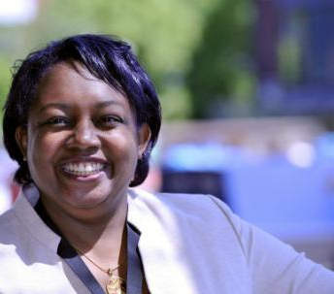
The author: Malorie Blackman
TASK: Choose three facts that you will remember about me and write them down in your book!
Hello Team Dannell!
I’m Malorie Blackman and I have written
books for many years.
I used to want to be an English teacher when I was a child but then I discovered I was good at writing!
I am so good at writing I have 79 published pieces of work, ranging from books to plays and TV Scripts!
I am married and I have a daughter too. In my spare time I like writing poetry and playing my piano.
I was the Children’s Laureate from
2013-2015.
Click me

Slide 4

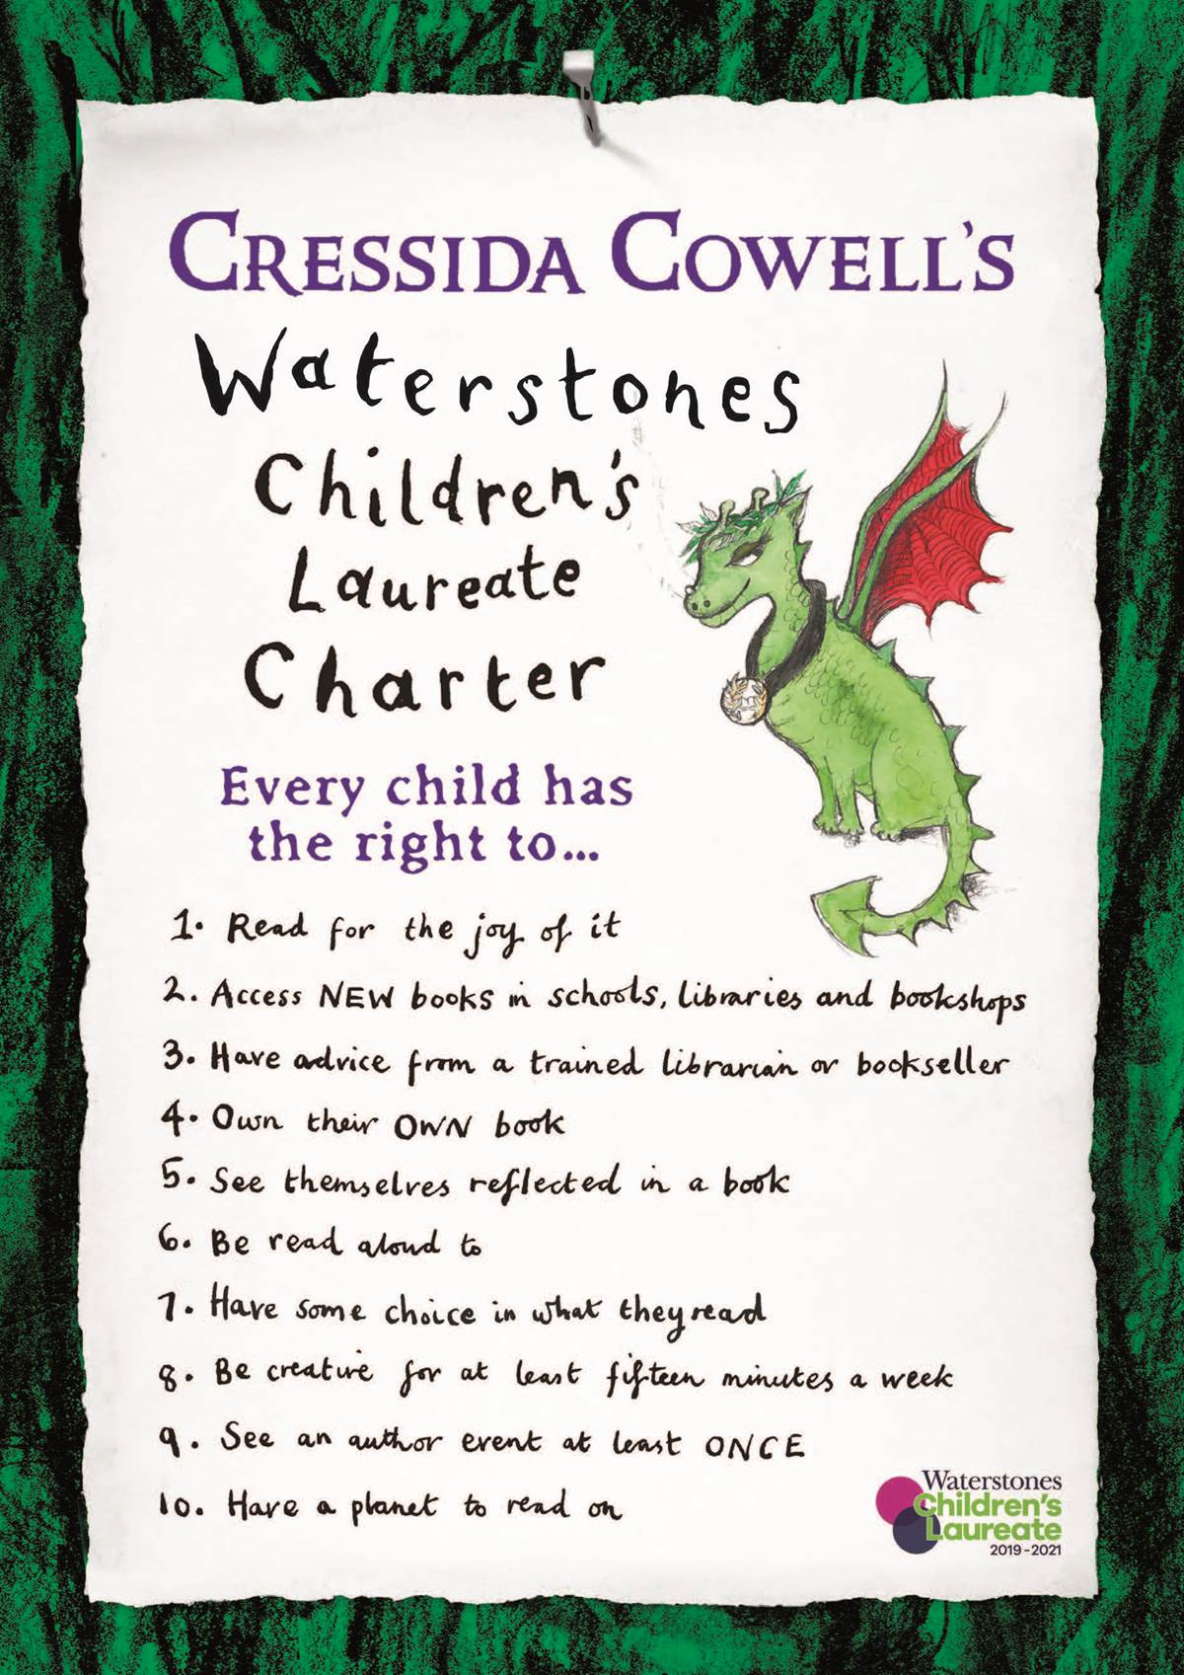
What is a children’s Laureate?
Click me
The role of Children's Laureate is awarded once every two years to an famous writer or illustrator of children's books to celebrate outstanding achievement in their field.
The current children’s laureate is Cressida Cowell who wrote ‘How to Train Your Dragon’.

Slide 5
The novel we will study involves these things…
What do you think will happen?
Come up with a storyline that includes all of these things.
A boy called Cameron
A heart which doesn’t work
A heart which does work
A pig called Trudy
A transplant operation
Click me

Slide 6

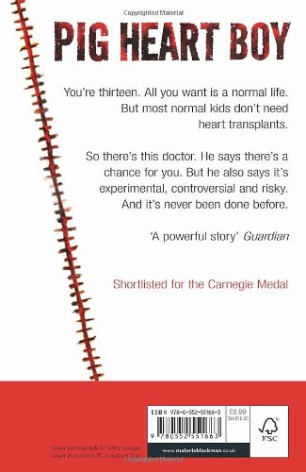
Let’s look at the book cover!
Click me
1. What can you guess based on the TITLE?
3. What can you guess based on the BLURB?
2. What can you guess based on the IMAGE?
4. What can you guess based on the REVIEWS/
COMMENTS?

Slide 7
Have you ideas changed?
STRUGGLING?
Think about the key words from the lesson and start by using them in a sentence:
novel,
author,
heart,
transplant
Think back earlier in the lesson, have your ideas changed?
Think again and answer the following question:
What do you think will happen in the book?
CHALLENGE!
Use the following connectives in your discussion:
However,
moreover,
consequently,
furthermore

Slide 8

Task
Write 1 word to summarise how you feel about the book.
Write 2 questions you would like answering.
Write 3 facts you remember about the author!

