Slide 1
IK: the different animal groups

Slide 2
Classification of Animals
Scientists have divided the Animal Kingdom into two main groups:
vertebrates (animals with a backbone)
and
invertebrates (animals without a backbone)

Slide 3
Vertebrates
Animals with backbones can be divided into five more groups:
Mammals
Birds
Reptiles
Amphibians
Fish

Slide 4
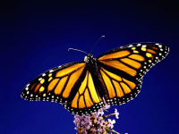
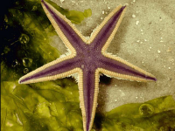
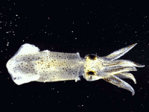
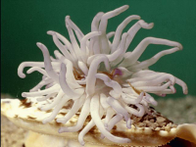
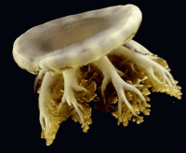
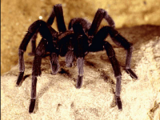
Invertebrates
Animals without a backbone.

Slide 5
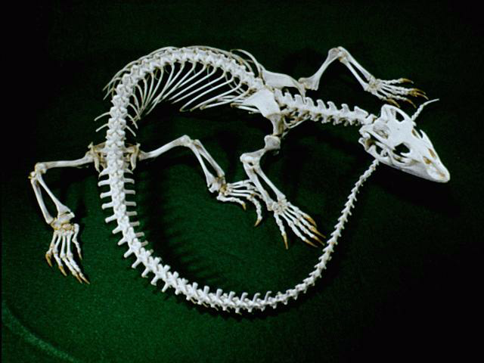
Vertebrates
Animals with a backbone.

Slide 6
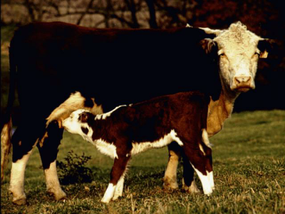
Mammals
Give birth to live young.
Feed their babies with their own milk.
Are more or less covered with hair.
Are warm-blooded.
About 4000 species
Some live in water, some don’t

Slide 7
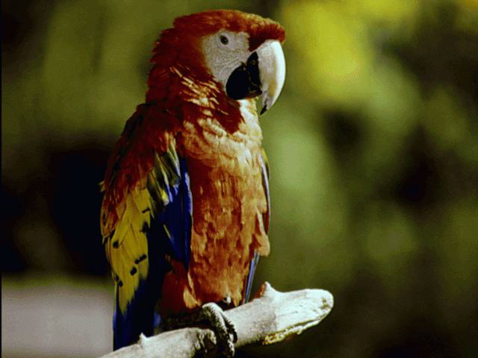
Birds
Have feathers.
Lay hard-shelled eggs.
Are warm-blooded.
Hollow bones
Around 10,000 species
Not all birds can fly

Slide 8
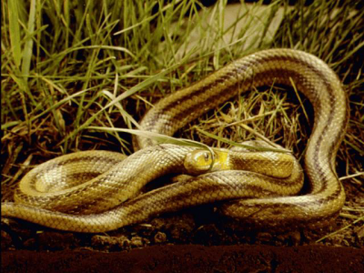
Reptiles
Are cold-blooded.
Most lay soft-shelled eggs.
Have a dry skin covered with scales.
Some have legs, some don’t
Live on land

Slide 9
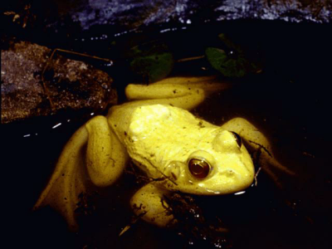
Amphibians
Are cold-blooded.
Lay eggs.
Have a smooth, moist skin.
Are able to live on land as well as in the water
Tend to live in moist places to stop their skin from drying out
More than 4000 species

Slide 10
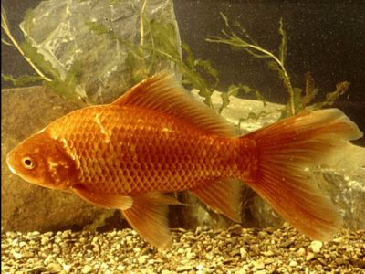
Fish
Are cold-blooded.
Lay eggs (but some do give birth to live young).
Have a moist skin covered in scales.
Breathe through gills.
Live and breathe underwater
Fish make up about half of all known vertebrate species

Slide 11
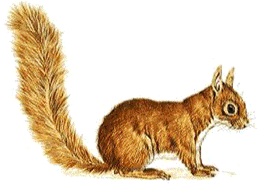
What am I?
Mammal, Bird, Fish, Amphibian or Reptile?
I am a mammal. My body is warm and furry. I feed my babies on milk. I give birth to live young.

Slide 12
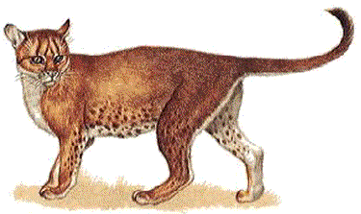
What am I?
Mammal, Bird, Fish, Amphibian or Reptile?
I am a mammal. My body is covered in hair, or fur. I feed my babies on milk. I give birth to live young.

Slide 13
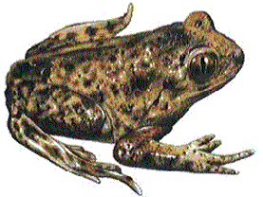
What am I?
Mammal, Bird, Fish, Amphibian or Reptile?
I am an amphibian. My body is moist and smooth. I lay eggs. I like to live in or near to water.

Slide 14
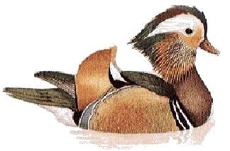
What am I?
Mammal, Bird, Fish, Amphibian or Reptile?
I am a bird. My body is warm and covered with feathers. I lay eggs which hatch out into chicks.

Slide 15
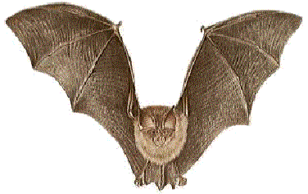
What am I?
Mammal, Bird, Fish, Amphibian or Reptile?
Although I have wings, I am in fact a mammal. My body is covered in hair, not feathers. I feed my babies on milk. I do not lay eggs.

Slide 16
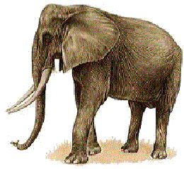
What am I?
Mammal, Bird, Fish, Amphibian or Reptile?
I am a mammal. If you stand very close to me, you will see I have hairs on my body. I feed my babies on milk. I do not lay eggs.

Slide 17
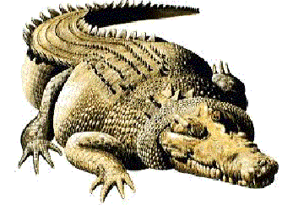
What am I?
Mammal, Bird, Fish, Amphibian or Reptile?
I am a reptile. My body is covered in dry scales. I lay eggs.

Slide 18
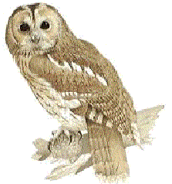
What am I?
Mammal, Bird, Fish, Amphibian or Reptile?
I am a bird. My body is warm and covered with feathers. I lay eggs which hatch out into chicks.

Slide 19
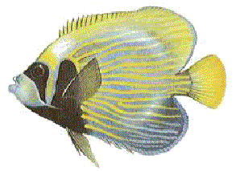
What am I?
Mammal, Bird, Fish, Amphibian or Reptile?
I am a fish. My body is cold to touch and is covered in scales. I lay eggs. I use gills to breathe with under water.

Slide 20
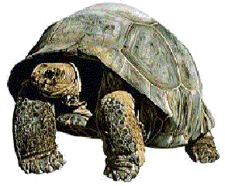
What am I?
Mammal, Bird, Fish, Amphibian or Reptile?
I am a reptile. My body is covered in dry scales. I lay eggs.

Slide 21
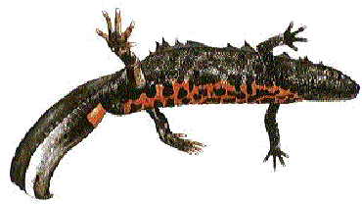
What am I?
Mammal, Bird, Fish, Amphibian or Reptile?
I am an amphibian. My body is moist and smooth. I lay eggs. I like to live in or near to water.

Slide 22
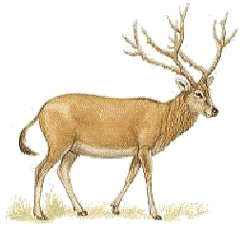
What am I?
Mammal, Bird, Fish, Amphibian or Reptile?
I am a mammal. My body is warm and furry. I feed my babies on milk. I give birth to live young.

Slide 23
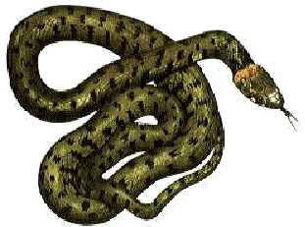
What am I?
Mammal, Bird, Fish, Amphibian or Reptile?
I am a reptile. My body is covered in dry scales. I lay eggs.

Slide 24
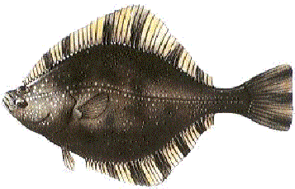
What am I?
Mammal, Bird, Fish, Amphibian or Reptile?
I am a fish. My body is cold to touch and is covered in scales. I lay eggs. I use gills to breathe with under water.

Slide 25
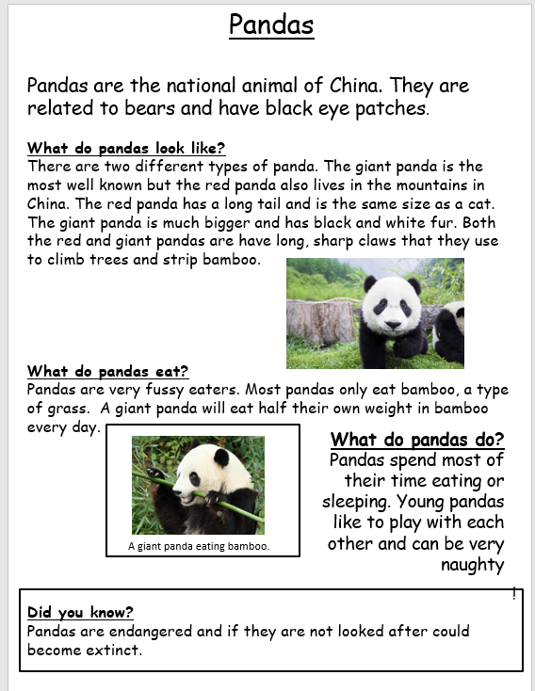
What is a non-chronological report?
An information page!

Slide 26
Classifying Animals
‘Classifying’ means grouping animals according to their characteristics. Animals can be classified into two main groups: vertebrates and invertebrates. Vertebrates are animals with a backbone such as mammals, birds and reptiles. Invertebrates are animals without a backbone such as insects and arachnids (spiders and scorpions).
Read on to find out more about vertebrates.
Birds
All birds have feathers and lay hard-shelled eggs. They are warm-blooded and have hollow bones which makes they lighter so they can fly. There are around 10,000 species of bird but not all birds can fly.
Mammals
Mammals give birth to live young and they feed their babies with their own milk. They are more or less covered with hair and they are warm-blooded. There are around 4000 species of mammals (fewer than birds) and some live in water, for example whales, and some don’t such as cats and dogs.

Slide 27
Success criteria:
Introduction
Explain what ‘classification’ means
Explain how animals can be classified into 2 groups
Explain what a vertebrate and an invertebrate is
Put subtitles for each vertebrate
Mammals
Birds
Reptiles
Amphibians
Fish
Give information about each one, writing in full sentences
Draw pictures if you have time

