Slide 1
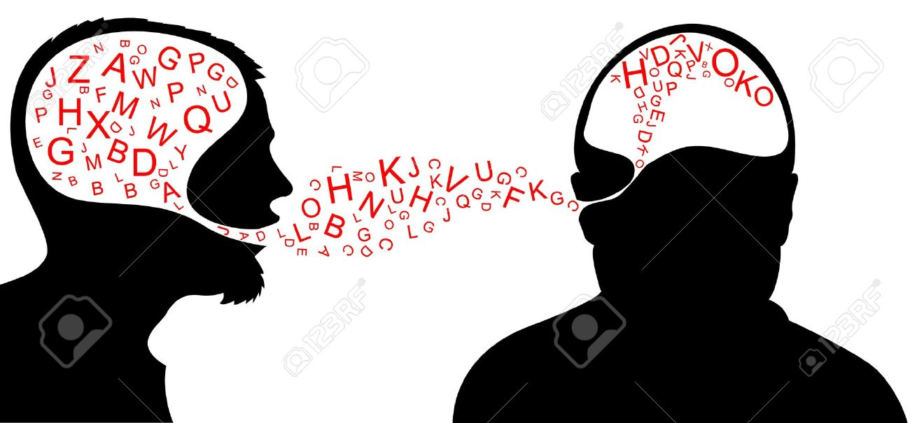
Starter:
What can you remember from Thursday’s lesson? Who is the author? What can you remember about her? What is the book about?
Make sure you use the keywords from the lesson: transplant, heart, novel, author!

Slide 2
Pig Heart Boy
KEYWORDS FOR TODAY:
PROLOGUE
STRUCTURE
PROTAGONIST
IALT
Understand the opening chapters of the book.
Explain in my own words what I have read.

Slide 3
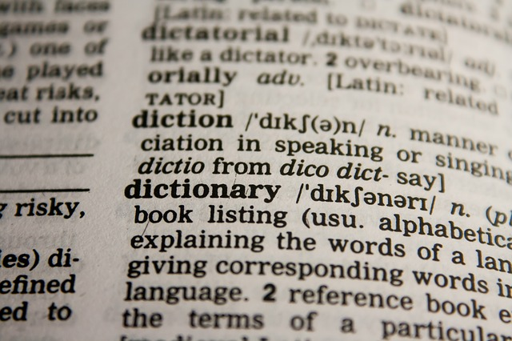
Keyword Dictionary Challenge!
Look up the following 3 words and write the definitions in your book.
PROLOGUE
STRUCTURE
PROTAGONIST

Slide 4
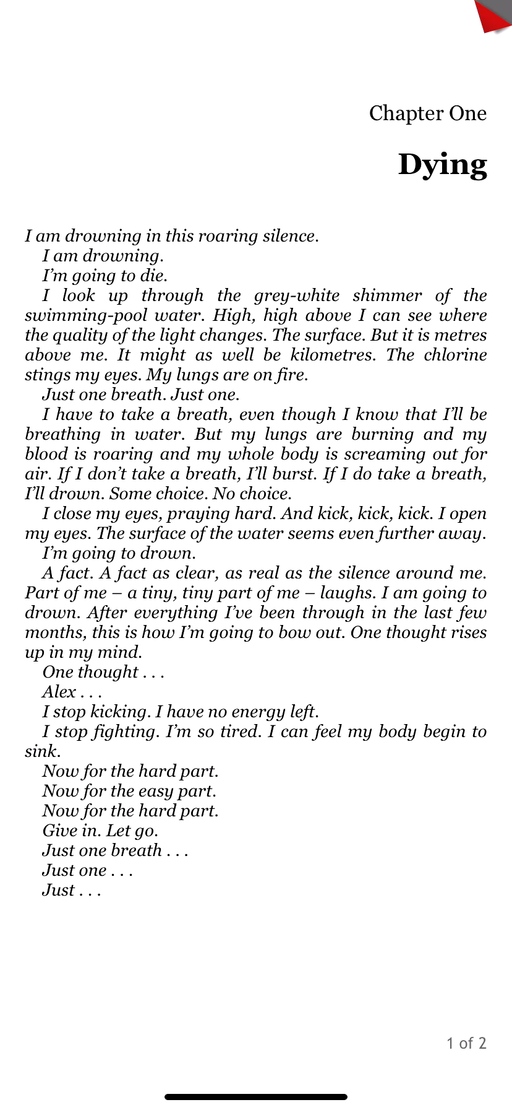

Let’s read the Prologue:
‘Consequences, Chapter 1’.
What is a ‘consequence’?
What can you guess about the book based on the title of this section?
Play the video to hear Chapter 1

Slide 5
Chapter 1:
Questions
ANSWER IN FULL SENTENCES!
Challenge:
Try to use some words from the book in your answers (a quotation).
Who do you think we hear from?
Do you think the person is speaking or thinking? Why?
Where do you think the character is and why?
Need help?
Click for clues!
.

Slide 6
Chapter 1:
Questions
ANSWER IN FULL SENTENCES IN YOUR BOOK!
Challenge:
Try to use some words from the book in your answers (a quotation).
Who do you think we hear from?
Do you think the person is speaking or thinking? Why?
Where do you think the character is and why?
Need help?
Click for clues!
1)Clue: Protagonist!
2)Clue: look at the punctuation.
3)Clue: chlorine is used in certain type of pool
.

Slide 7

Plenary Brain!
Inside the brain write down everything you’ve learned this lesson.
Around the outside write down any questions you have about the work you’ve done today.

