Slide 1
Speaking and Listening SETTLER Task
STUCK:
Look back at the work you did to remind you what some of these words mean.
Talk to yourself! (it’s not the first sign of madness!) Answer the following questions:
What has happened so far in the book?
Who is the protagonist?
What do we know about the protagonist so far?
What happened in the prologue of the book?
What do you think will happen in the next chapter of the book?
TOO EASY?
Use the following words in your discussion:
Thoughtful, throughout, consequently,
as a result,
repeatedly

Slide 2
Pig Heart Boy
KEYWORDS FOR TODAY:
COMMAND
IMPERATIVE
VERB
IALT:
understand what an imperative verb is.
be able to use imperative verbs in my own work.

Slide 3

Keyword Dictionary Challenge!
COMMAND
IMPERATIVE
VERB

Slide 4
SPOT THE VERBS – 1 point for each one you spot!
I thought my head was about to explode.
I sat down at the bottom of the pool.
I closed my eyes.
He swam off towards the middle of the pool.
I looked straight ahead, listening to every word they said.
TASK:
Write down these sentences underlining each VERB you see!

Slide 5
SPOT THE VERBS – How did you do?
I thought my head was about to explode.
I sat down at the bottom of the pool.
I closed my eyes.
He swam off towards the middle of the pool.
I looked straight ahead, listening to every word they said.
TASK:
Write down these sentences underlining each VERB you see!

Slide 6

What’s an ‘Imperative Verb’?
Any guesses?
Here’s a clue:
That’s right! An imperative verb is a ‘bossy’ verb.
Imperative verbs usually give instructions.

Slide 7
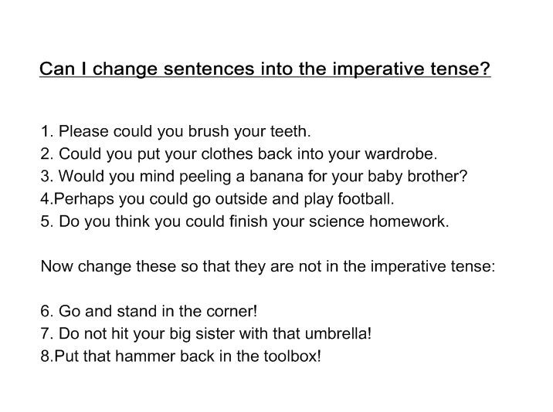
Now change these ones so they aren’t imperatives.
Sort these sentences into the imperative tense (make them bossy!)

Slide 8
Writing Activity
Choose from one of the following writing activities – make sure you are using imperative verbs in your writing.
1: Create a poster for the swimming pool saying that Daredevil Dive is banned.
On your poster explain why it is banned and what will happen to anyone seen playing.
2: Write a letter addressed to Marlon’s parents from the company who run the swimming baths explaining that their son has broken rules and will now be banned from the swimming baths.
3: Write a conversation between Marlon and a lifeguard using correct SPaG with speech. Write it as if it will be slotted into the story.

