Slide 1
PLANT REPRODUCTION
UPPER KEY STAGE 2
Registered charity number 1153740

Slide 2
HOW DO PLANTS REPRODUCE SEXUALLY?

Slide 3
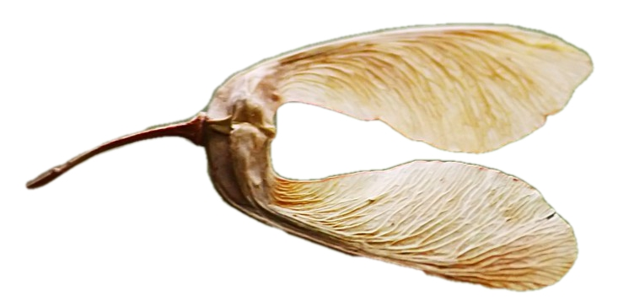
Plant Growth
Stem grows up, leaves unfold, flower bud forms and opens
Pollination
Insects attracted to the flower transport pollen, or the wind blows pollen between plants
Fertilisation
seeds form when pollen from the male part of one flower reaches the female parts of another flower
Seed Dispersal
Seeds are scattered away from the parent plant
Germination
With water and a suitable temperature the seed swells and begins to make a new plant
Life Cycle of a Plant

Slide 4
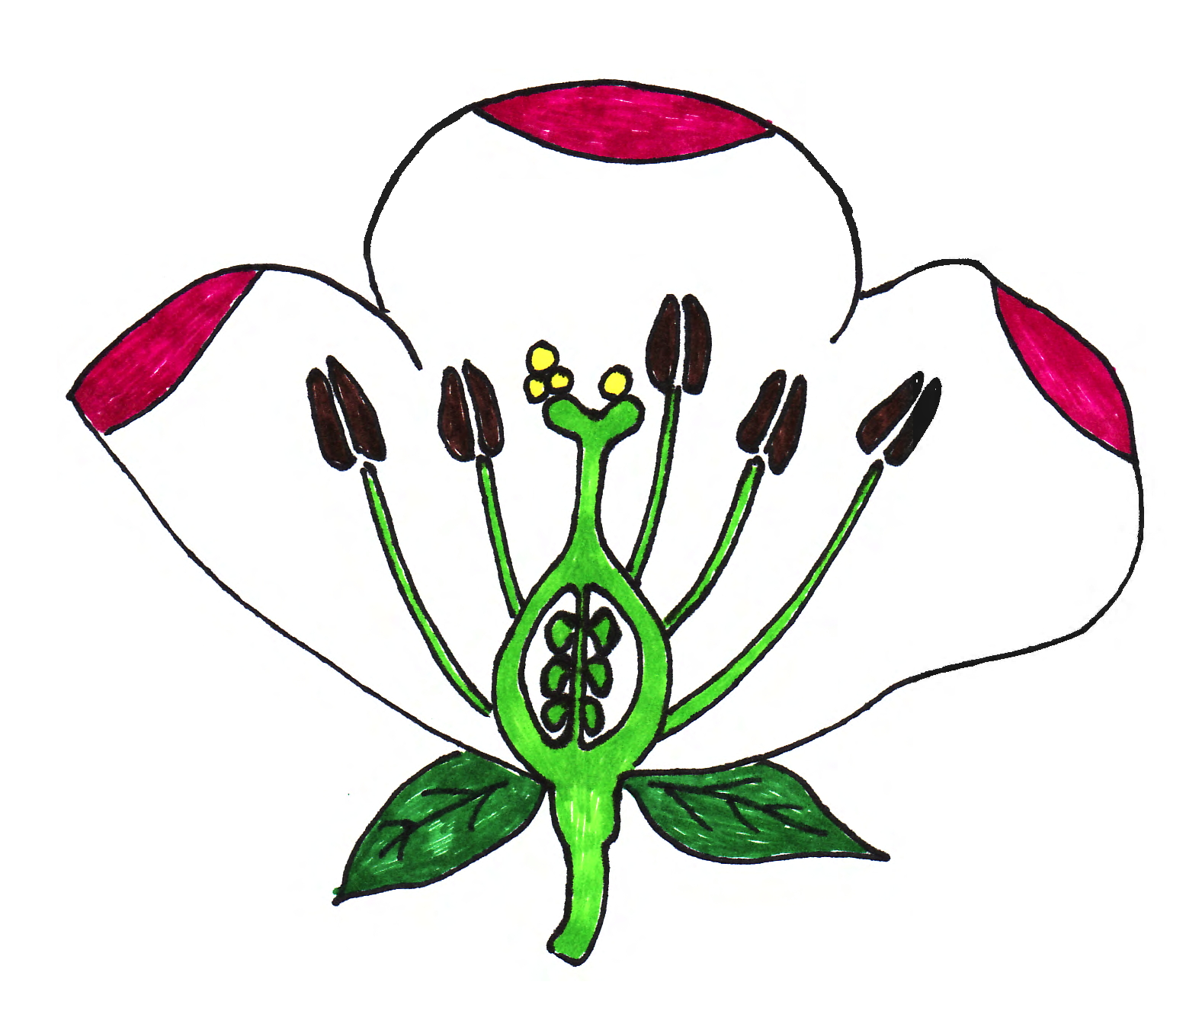
The Parts of a Flower
petal
pollen
stigma
anther
style
Carpel
stamen
filament
ovary
ovule
sepal
receptacle

Slide 5
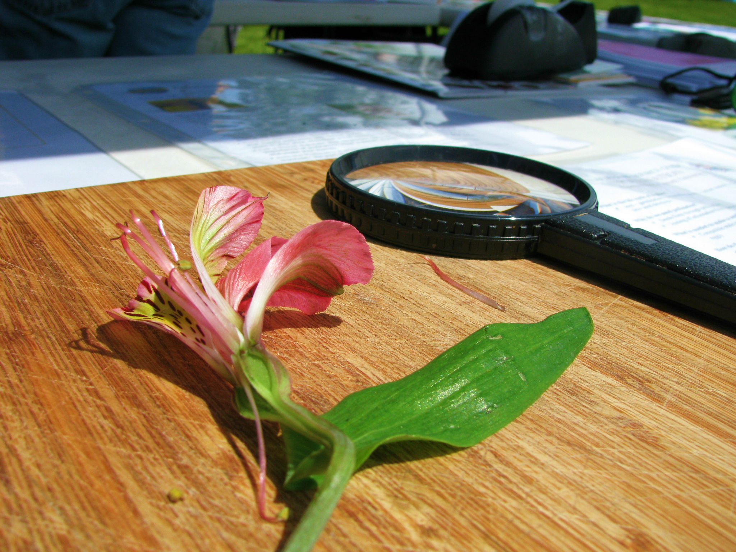
A lily’s flower has clear reproductive organs
Photo: USFWS: Pacific Region

Slide 6
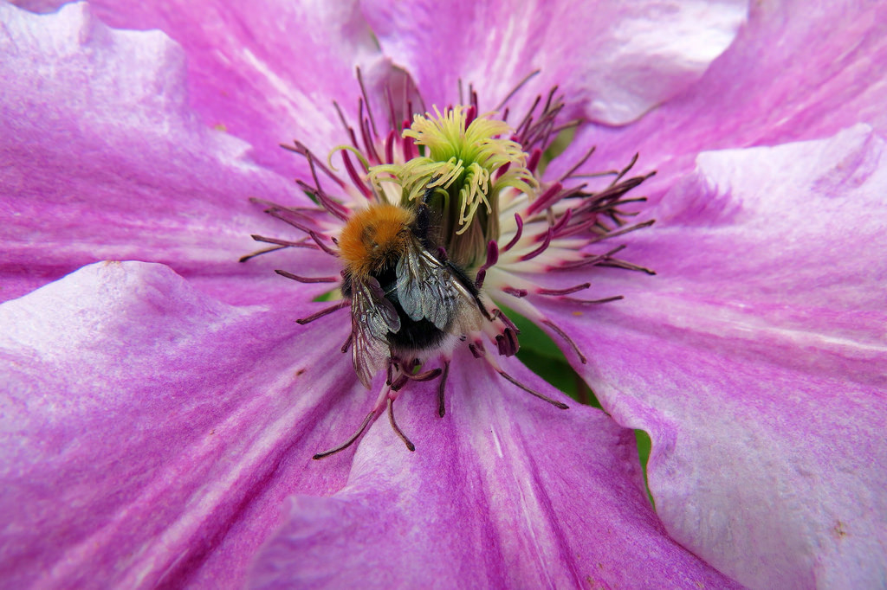
Brightly coloured petals attract insects and provide a landing platform
Photo: Darling Starlings

Slide 7
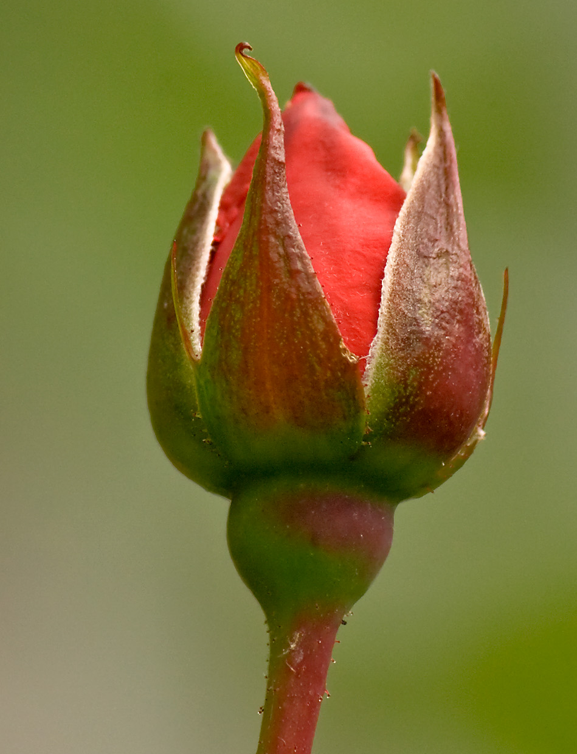
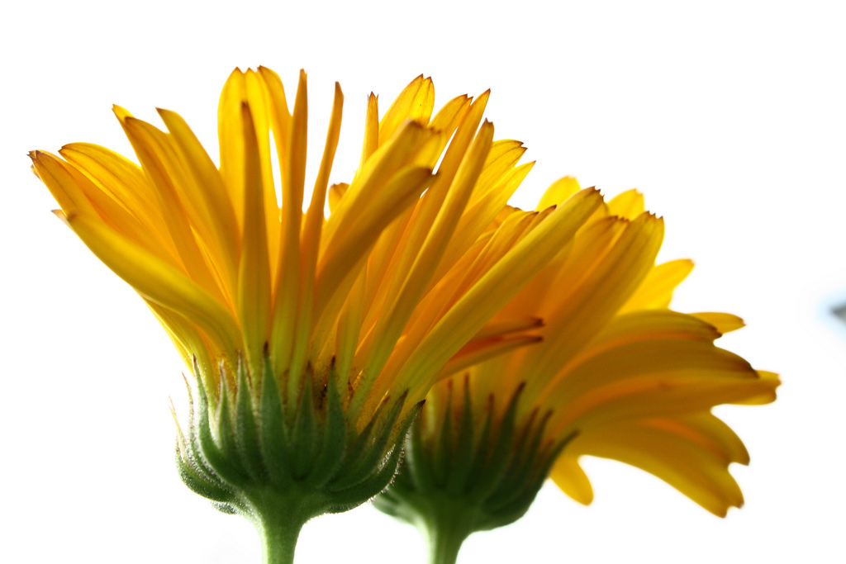
The sepals protect the flower whilst it is still a bud
Photo: Mike Freedman
sepals
Photo: Billy Wilson

Slide 8
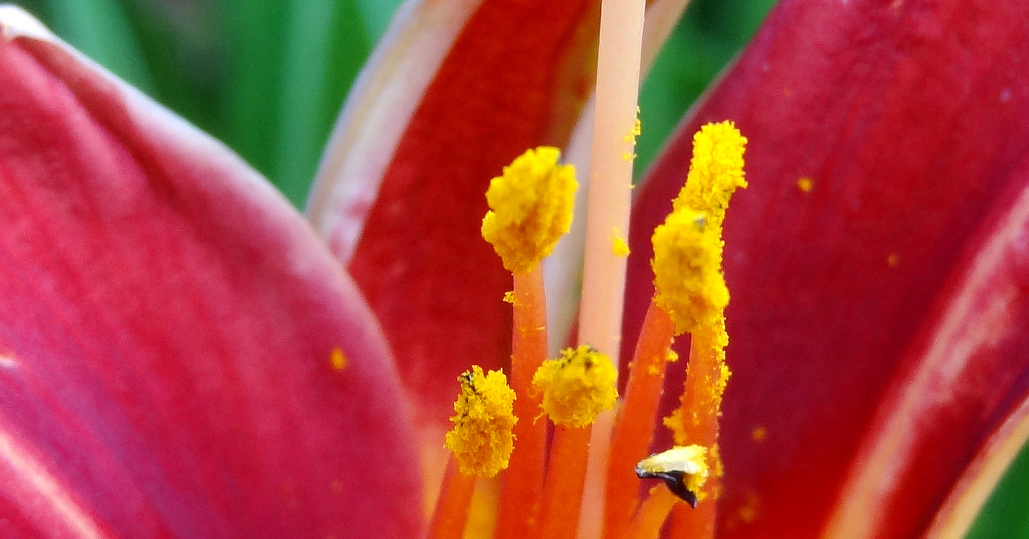
Pollen on lily stamens
anther
filament
Photo: Martin LeBar

Slide 9
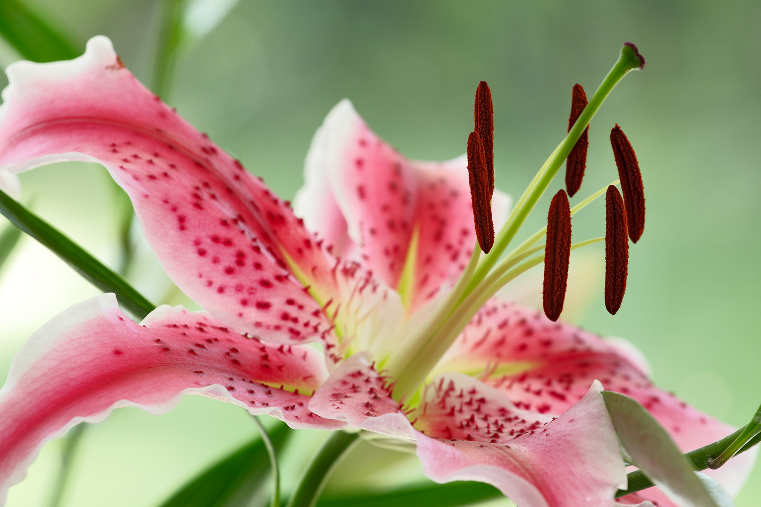
The female part of a flower is called the carpel
stigma
style
ovary
Photo: James Blunt

Slide 10
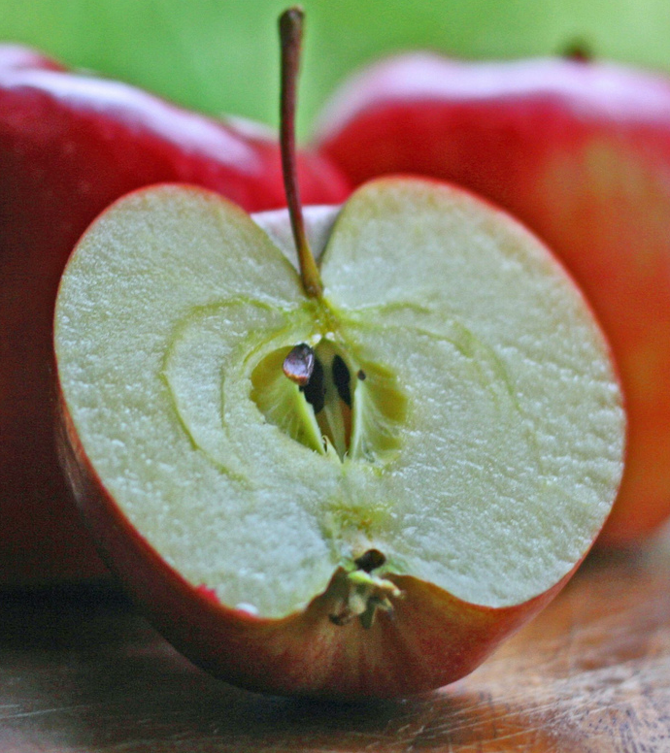
The apple is a good example of how parts of the flower help to form the fruit
The stem
Seeds (pips) and ovary wall forming the core
Fleshy part – the top of the flower stalk (receptacle)
Remains of sepals and styles
Photo: Mary Beth Griffo Rigby

Slide 11
HOW DO PLANTS REPRODUCE ASEXUALLY?

Slide 12
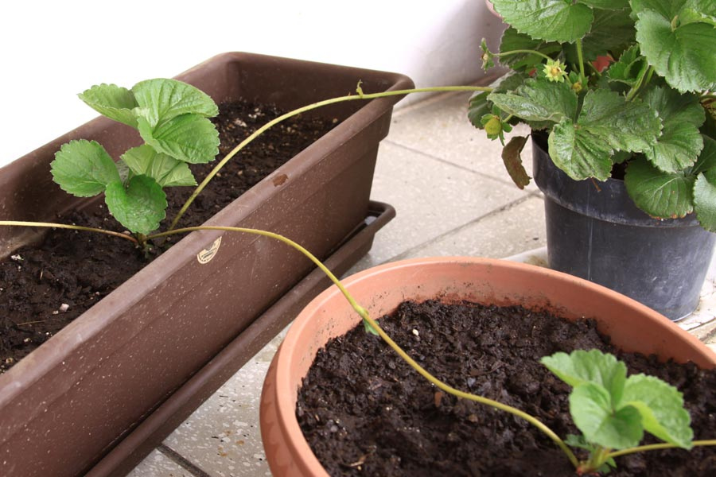
Strawberry runners
Photo: Candy Tale

Slide 13
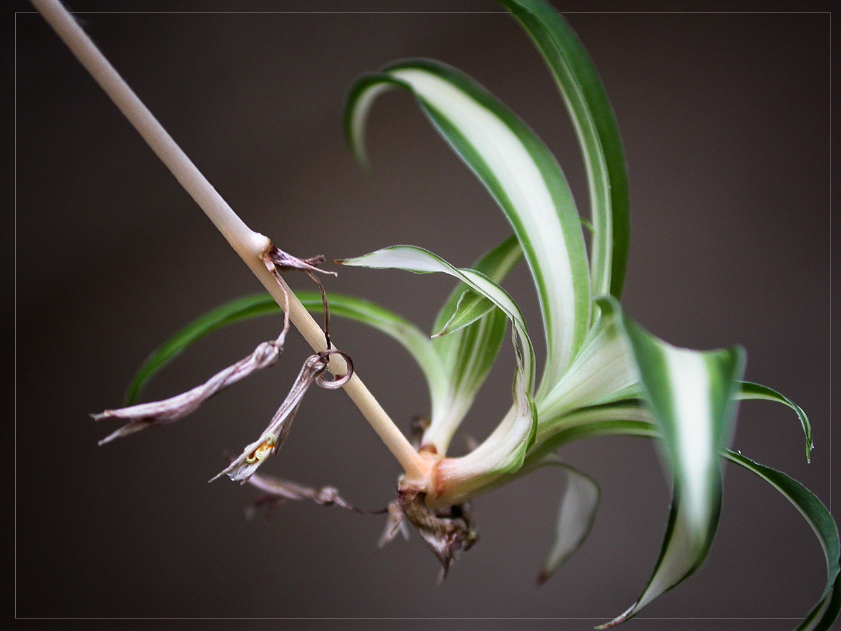
This spider plant has sent out a long runner and formed a plantlet at the far end. This plantlet can be planted in another pot and will take root.
Photo: Colin

Slide 14
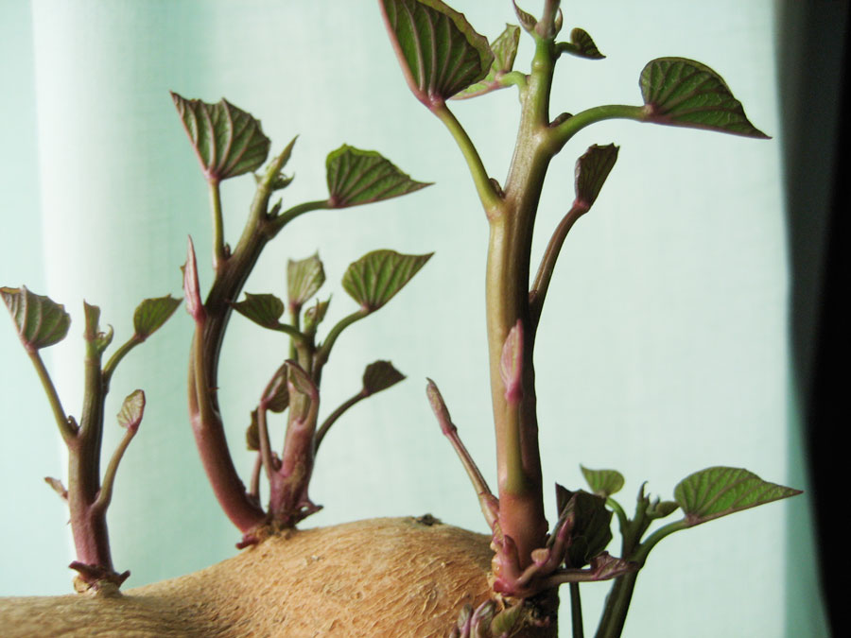
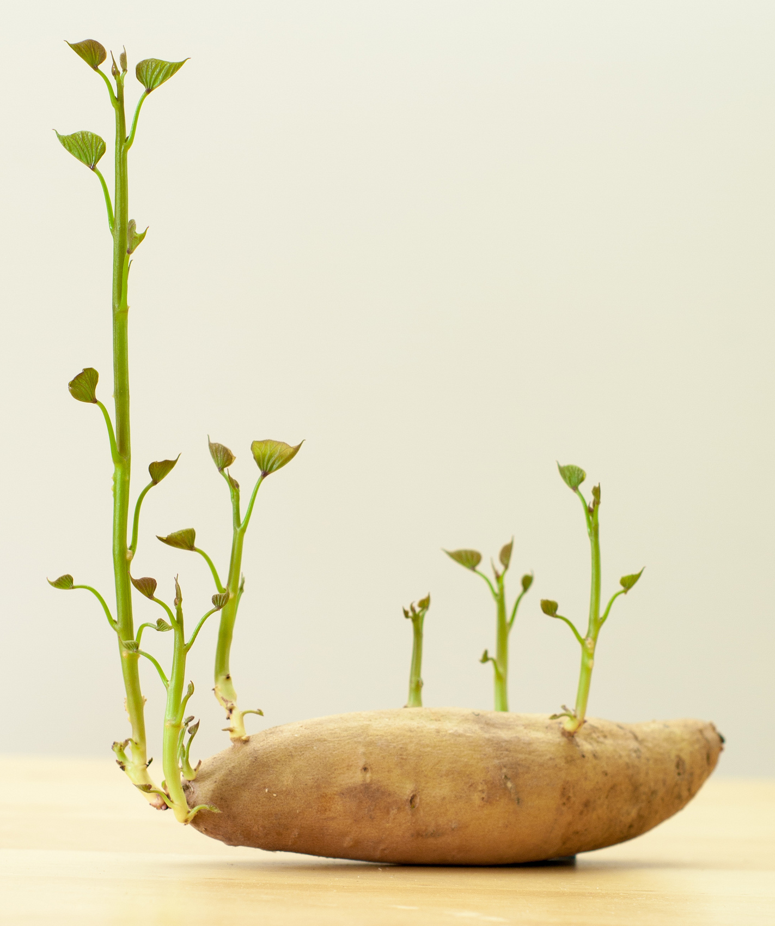
Photo: Aimee Ray
Sweet potatoes – buds form new shoots
Photo: Moss

Slide 15
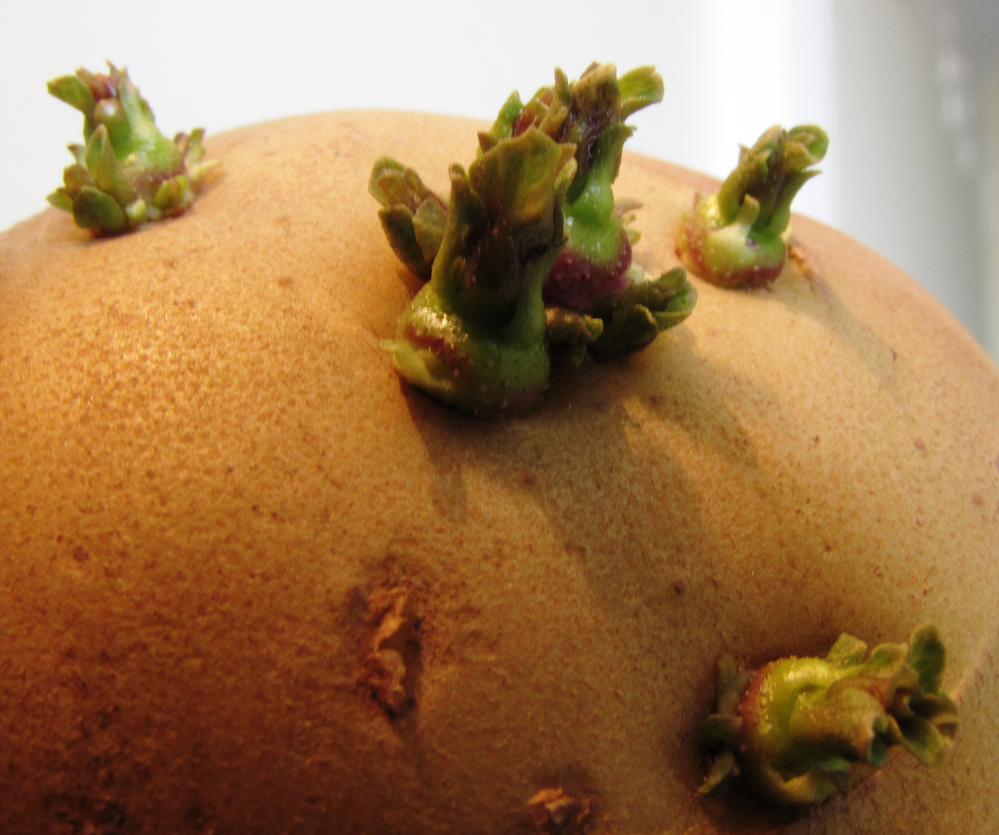
Sprouting Potato Tubers
Shoots
Eyes
Photo: Jatinder Joshi

Slide 16
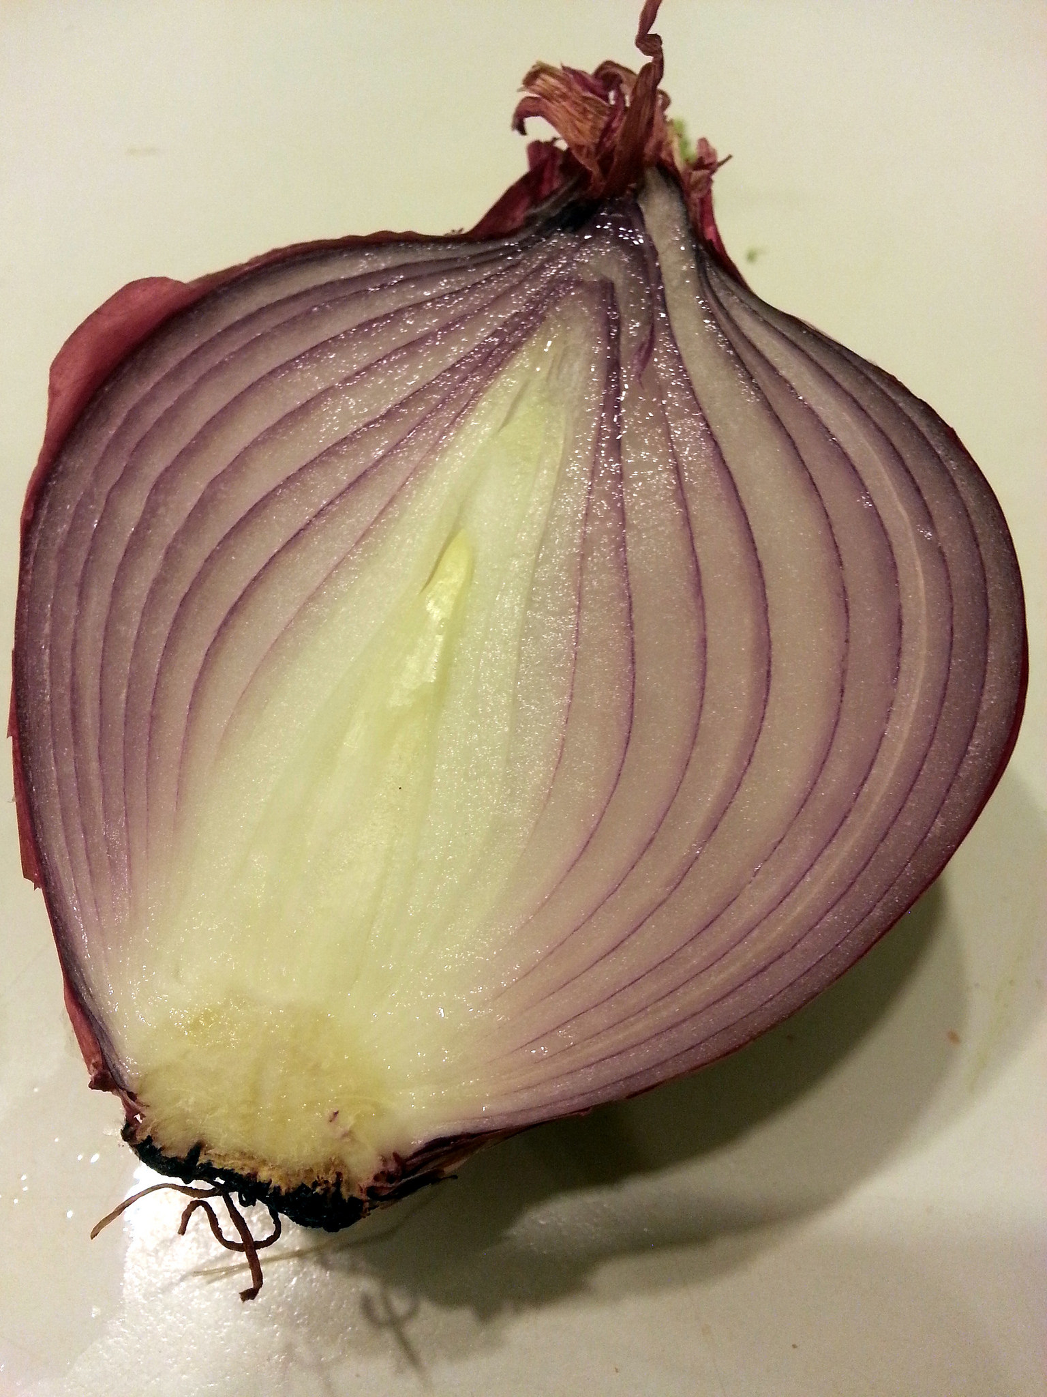
The structure of a bulb
Flower bud
(future flower stored inside the bulb for protection)
Scale leaves
(fleshy modified leaves that store food)
Thick modified stem
Roots
Photo: Adrian Tritschler

Slide 17
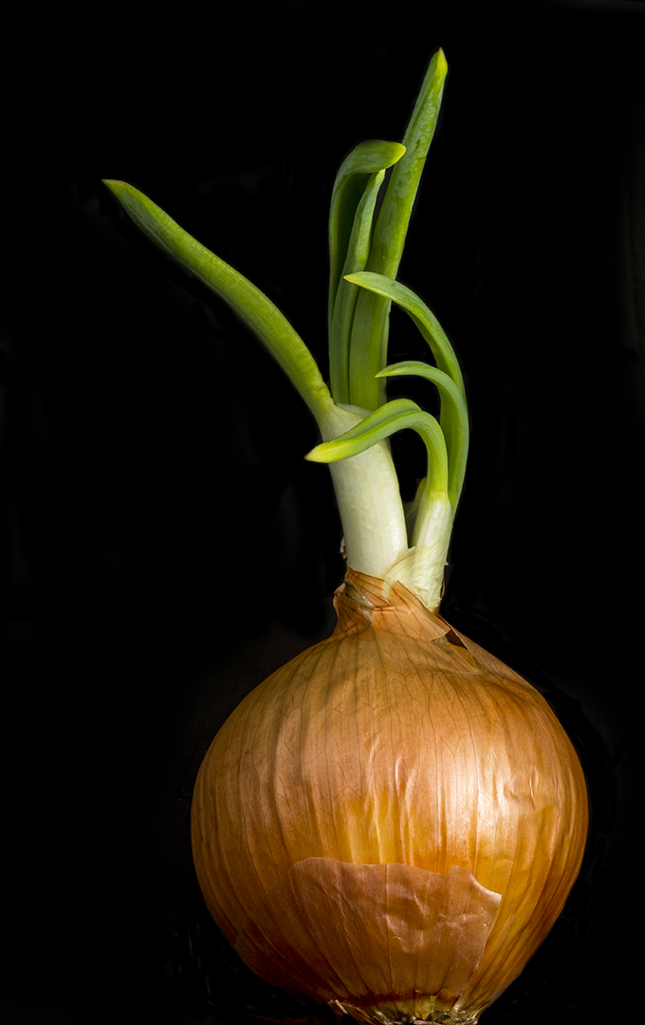
New shoots developing from an onion bulb
Photo: Bill Gracey

Slide 18
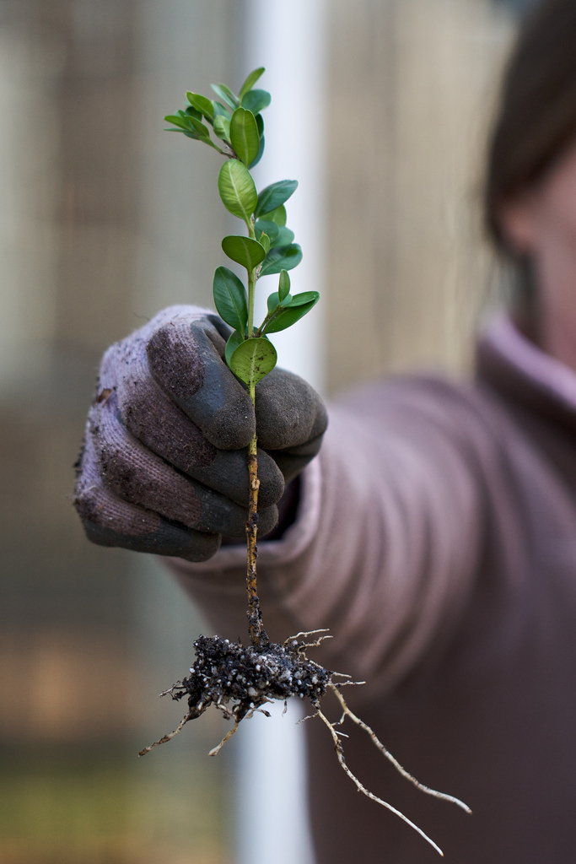
Artificial Propagation
The stem cutting of a box tree has been planted - now it has grown new roots!
Photo: Susy Morris

Slide 19
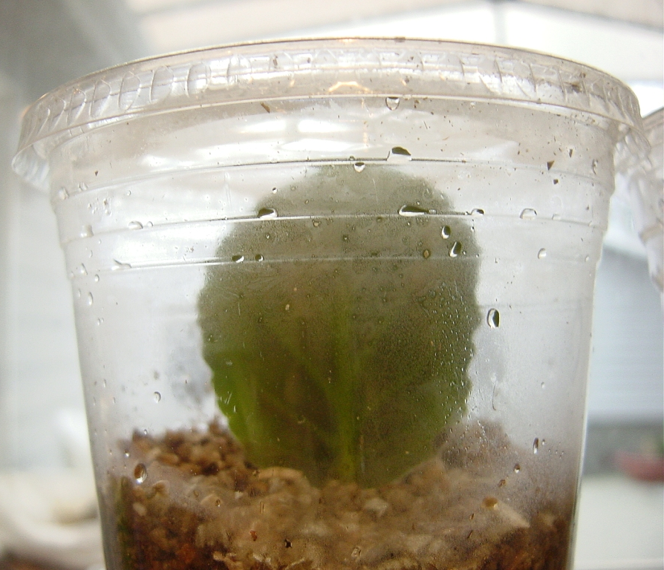
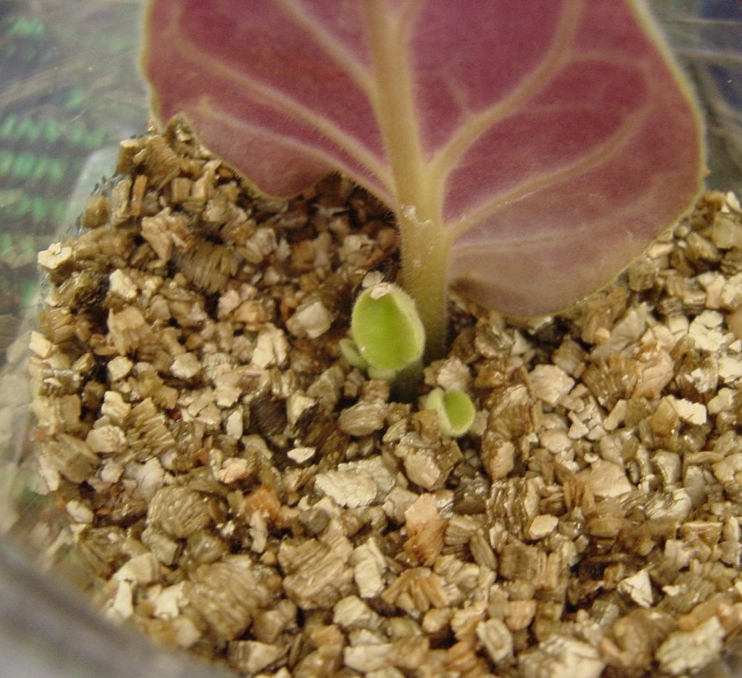
A leaf cutting from an African violet was planted
Photo: SatrinaO
A few months later, new roots have grown and little baby leaves have sprouted! A new African violet has been made.
Photo: SatrinaO

Slide 20
To find out more, please visit
ypte.org.uk
Registered charity number 1153740
Creating a better future by inspiring young people to look after our world

