Slide 1
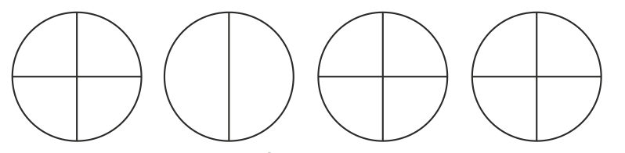
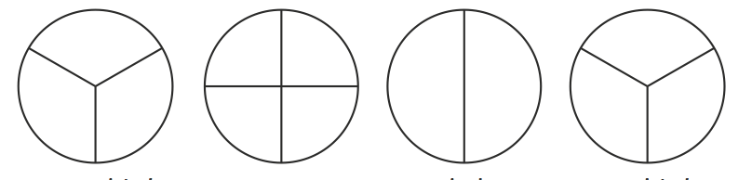
IALT: Find fractions of shapes
Task A: Colour in the amount below:
2/4 ½ ¾ 1/4
2/3 2/4 1/2 2/3

Slide 2
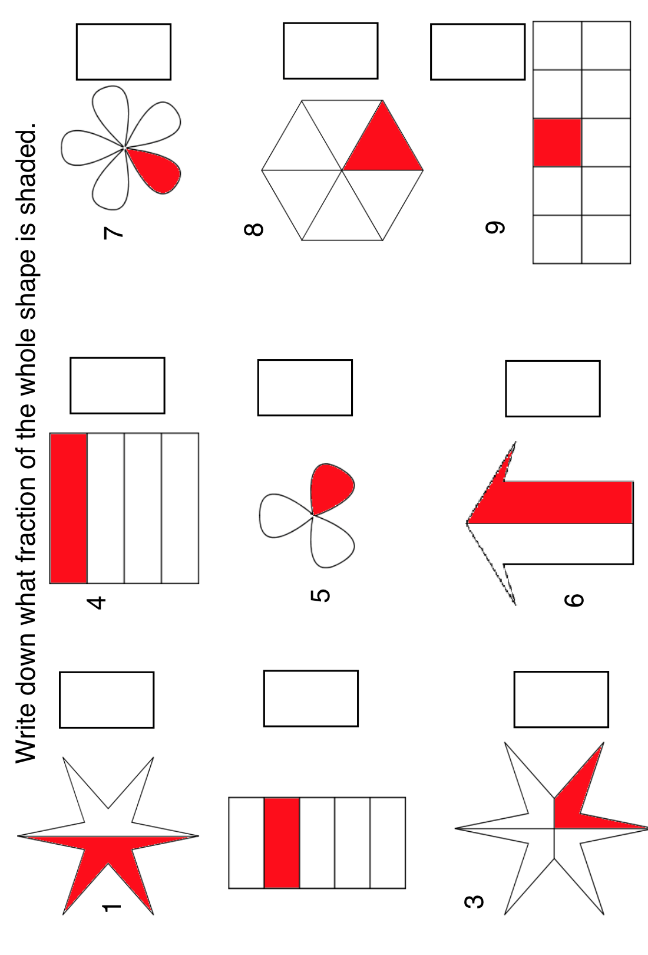
IALT: Find fractions of shapes
Write the fraction shaded in the box.

Slide 3
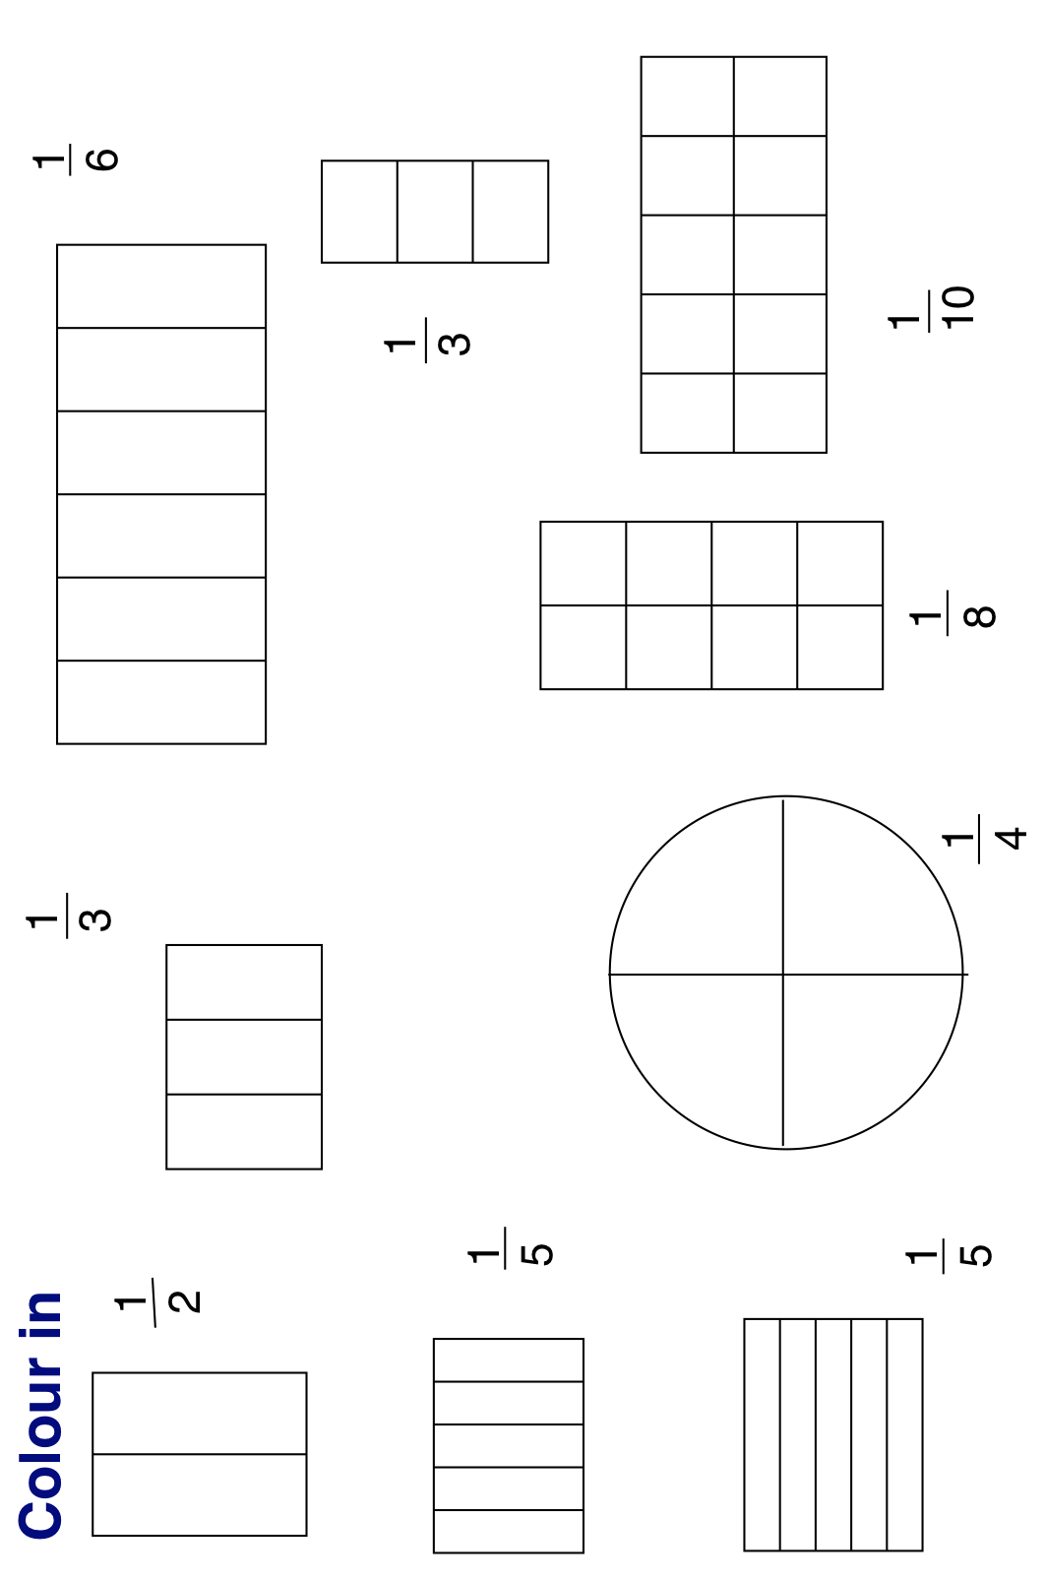
IALT: Find fractions of shapes
Colour the fraction given.

