Slide 1
Starter:
(what are they? Why do people have them? Why might somebody refuse one?)
Have a think about the following topics - there are questions to help you guide your thoughts if you are struggling to get started ☺
Heart transplants
Using animals for scientific reasons
The novel so far
(what could they be used for? How do you feel about animals being tested on for new products? Do you agree with using animals for scientific purposes?)
(what do you like about it? What has happened so far? What don’t you like about it and why?)

Slide 2
Day Dreaming.
Keywords:
Clause
Simple
Compound
Lesson Objectives:
To be able to write descriptively.
To understand how to develop tension using a variety of sentence structures.

Slide 3

Keyword definition:
COUNTDOWN CONUNDRUM!
Today’s key words are based around a particular aspect of writing. See if you can guess what it is by unscrambling these letters:
TSNENSECE

Slide 4
Keywords:
Match-up and write the definition in your book.
Simple
Compound
Clause
A section of a sentence.
A clause which makes sense on it’s own.
A sentence which has more than one clause, usually joined with punctuation or a connective.
Struggling?
Use a dictionary ☺
Finished?
Come up with an example of each.

Slide 5
Keywords:
Were you correct? Check your answers
Simple
Compound
Clause
A clause which makes sense on it’s own.
A sentence which has more than one clause, usually joined with punctuation or a connective.
A section of a sentence.
Did you get 3/3? Well done!

Slide 6
Simple OR Compound?
SIMPLE
Read the following sentences and decide if you think they are simple or compound:
Cameron was hungry.
Cameron was hungry but there was no food.
The food was cold.
The food was cold because it had been left on the side too long.
Cameron’s mom was upset.
Cameron’s mom was upset but his dad was ok.
The pig’s name is Trudy.
The pig’s name is Trudy and she has a healthy heart.
COMPOUND

Slide 7
Simple OR Compound?
SIMPLE
Check your answers! The yellow ones are simple and the green ones are compound.
Cameron was hungry.
Cameron was hungry but there was no food.
The food was cold.
The food was cold because it had been left on the side too long.
Cameron’s mom was upset.
Cameron’s mom was upset but his dad was ok.
The pig’s name is Trudy.
The pig’s name is Trudy and she has a healthy heart.
The trick is: if there is a connective, it’s a compound sentence.
COMPOUND

Slide 8
Building tension…
Read the following paragraph out loud.
What happens when the sentences turn from compound to simple?
“The waves crashed against the dark rocks as I felt around trying to grab something. Pebbles and seaweed tripped and grabbed me and the wind whistled a low mystical tune into my ears. A cold sensation tickled my spine when I thought suddenly of sharks swimming around me.
I was going to drown. I could feel it. I felt as if the black water was pulling me down. Down into the murky depths below.
“Help! Help!” I yelled. Then I saw something or someone. I swam hard. Maybe it was Mom. Or Dad! They were there, so close yet so far. It felt like days had past in the minutes it took to swim. I’d made it at last. But it wasn’t Mom and Dad. Just two pieces of driftwood floating idly.”

Slide 9

How to build tension
When we are writing we sometimes use sentences to build tension.
We can build tension by changing from compound to simple sentences.
By using simple sentences it makes us read the text quicker. It also makes us stop more often at full stops when the events sink in!

Slide 10
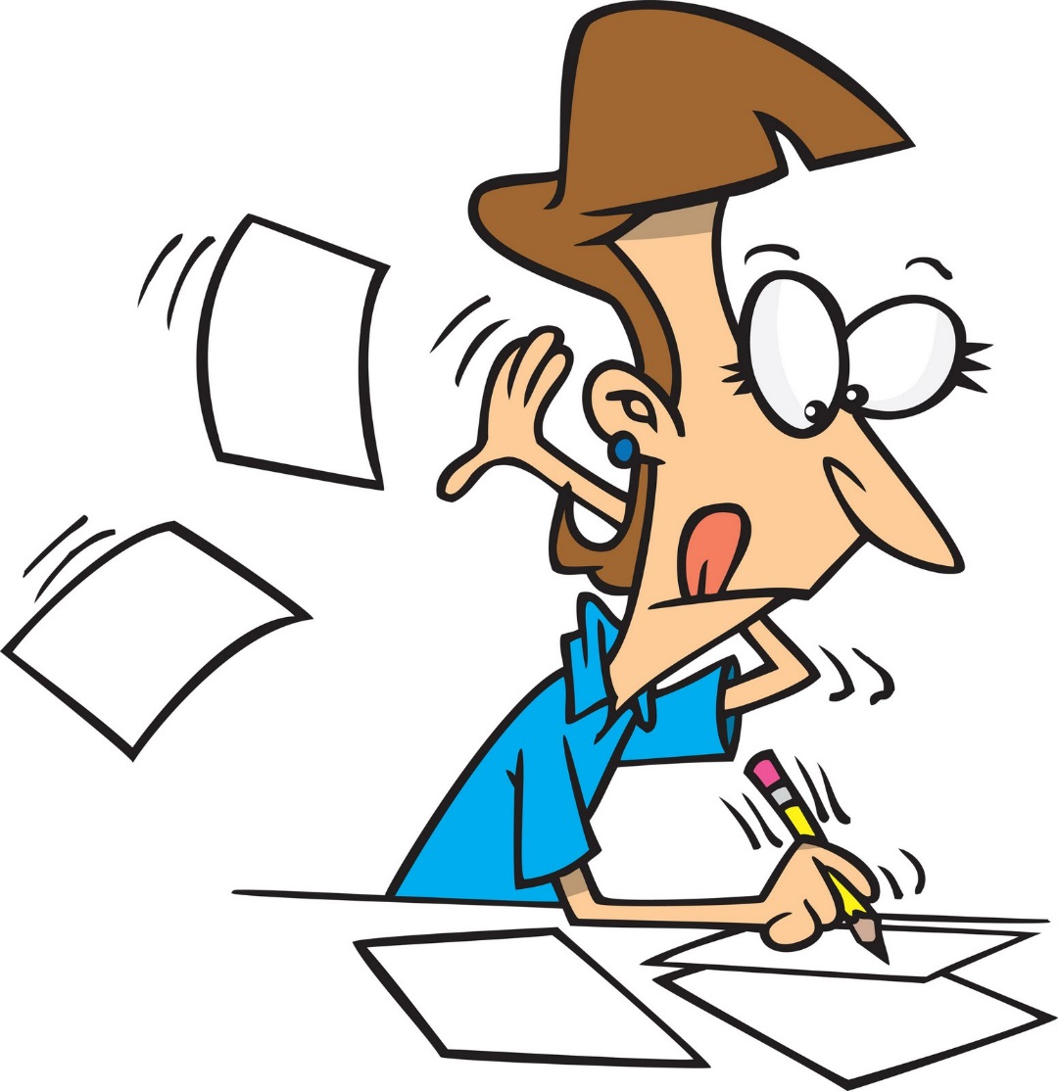
Day Dreaming…
At the end of Chapter 2 Cameron tells us that he usually ‘daydreams’ on his way home from school.
Today you’re going to have a go at writing up one of Cameron’s possible day dreams.
In your writing you need to prove that you can build tension by using a variety of simple and compound sentences.

Slide 11
Draw a thought bubble write out something Cameron may daydream about…
STRUGGLING: Choose from the following topics (school football games, playing Dare Devil Dive, telling Marlon about your fears for the future)
CHALLENGE: Aim to use a simile, some alliteration and AT LEAST 5 compound sentences in your writing.

Slide 12

Assessment.
Read your work back and underline all of the SIMPLE SENTENCES.
Now circle all the connectives in your compound sentences.

